Slide 1
Screening, Brief Intervention & Referral to Treatment
Thomas E. Freese, PhD, & Beth Rutkowski, MPH
UCLA Integrated Substance Abuse Programs
UCLA David Geffen School of Medicine, Dept. of Psychiatry
Pacific Southwest Addiction Technology Transfer Center
www.uclaisap.org
www.psattc.org
Notes:
Hello, my name is [ ] and I’d like to welcome you to the Screening, Brief Intervention, and Referral to Treatment or SBIRT training. We are very happy that you have joined us. Before we begin, let’s briefly introduce ourselves. Let’s go around the room and have each person state their name, their place of employment, and their line of work, e.g., nurse, social worker, psychologist. Also, tell us what you hope to gain from this course.

Slide 2

Training Goals
Increase knowledge of screening and brief intervention concepts
and techniques
Introduce and practice
screening and
identification skills
Review Motivational
Interviewing Skills needed
for doing Brief
Interventions
Develop skills to deliver the F.L.O. Brief Intervention
Notes:
At this point, I’d like to ask you to join me in an exercise. What we’re going to do is reflect on a difficult change that we made in our lives. You will not be asked to share the details of this change with anyone. What is something you really struggled with? Let’s take a few minutes to think about this time and to think about how this change came about and how long it took you to take action.
Allow the audience about 1 minute.
Did everyone think of something?
In my experience, any change takes time to commit to it. Even though a person may be thinking about changing, actually doing something about it or making an effort to change is really hard. Would anyone like to share how long it took from the point of considering a change to the point of taking action towards change?
Allow 2-3 minutes for discussion.
It is not uncommon for people to ponder change for a very long time before taking action—often years. SBIRT provides a way to speed this process up and help someone see the need for change and begin to do something about it.

Slide 3

Quick Activity: Reflection
Take some time to think about the most difficult change that you had to make in your life.
How much time did it take you to move from considering that change to actually taking action?
Notes:
At this point, I’d like to ask you to join me in an exercise. What we’re going to do is reflect on a difficult change that we made in our lives. You will not be asked to share the details of this change with anyone. What is something you really struggled with? Let’s take a few minutes to think about this time and to think about how this change came about and how long it took you to take action.
Allow the audience about 1 minute.
Did everyone think of something?
In my experience, any change takes time to commit to it. Even though a person may be thinking about changing, actually doing something about it or making an effort to change is really hard. Would anyone like to share how long it took from the point of considering a change to the point of taking action towards change?
Allow 2-3 minutes for discussion.
It is not uncommon for people to ponder change for a very long time before taking action—often years. SBIRT provides a way to speed this process up and help someone see the need for change and begin to do something about it.

Slide 4

We Don't Ask and We Don't Know What to Do
Substance use problems are often unidentified
In one study of 241 trauma surgeons, only 29% reported screening most patients for alcohol problems*
In another study of 1,082 primary care physicians and psychiatrists, 68% routinely screened for drug use**
  55% reported making formal referrals when drug abuse was found
  15% reported doing nothing
Notes:
At this point, I’d like to ask you to join me in an exercise. What we’re going to do is reflect on a difficult change that we made in our lives. You will not be asked to share the details of this change with anyone. What is something you really struggled with? Let’s take a few minutes to think about this time and to think about how this change came about and how long it took you to take action.
Allow the audience about 1 minute.
Did everyone think of something?
In my experience, any change takes time to commit to it. Even though a person may be thinking about changing, actually doing something about it or making an effort to change is really hard. Would anyone like to share how long it took from the point of considering a change to the point of taking action towards change?
Allow 2-3 minutes for discussion.
It is not uncommon for people to ponder change for a very long time before taking action—often years. SBIRT provides a way to speed this process up and help someone see the need for change and begin to do something about it.

Slide 5
Medical Consequences of
Substance Abuse
Substance abuse is a leading cause of illness and death. It can:
Lead to unintentional injuries and violence.
Exacerbate medical conditions (e.g. diabetes, hypertension, sleep disorders).
Exacerbate neuropsychiatric disorders (e.g. depression, sleep disorders).
Induce medical diseases (e.g. stroke, dementia, cancers).
Result in infectious diseases and infections (e.g. HIV, Hepatitis C).
Affect the efficacy of prescribed medications.
Be associated with abuse of prescription medications.
Result in low birth weight, premature deliveries, and developmental disorders.
Result in dependence, which may require multiple treatment services.
Conclusion: Substance abuse has a major impact on public health
Notes:
At this point, I’d like to ask you to join me in an exercise. What we’re going to do is reflect on a difficult change that we made in our lives. You will not be asked to share the details of this change with anyone. What is something you really struggled with? Let’s take a few minutes to think about this time and to think about how this change came about and how long it took you to take action.
Allow the audience about 1 minute.
Did everyone think of something?
In my experience, any change takes time to commit to it. Even though a person may be thinking about changing, actually doing something about it or making an effort to change is really hard. Would anyone like to share how long it took from the point of considering a change to the point of taking action towards change?
Allow 2-3 minutes for discussion.
It is not uncommon for people to ponder change for a very long time before taking action—often years. SBIRT provides a way to speed this process up and help someone see the need for change and begin to do something about it.

Slide 6
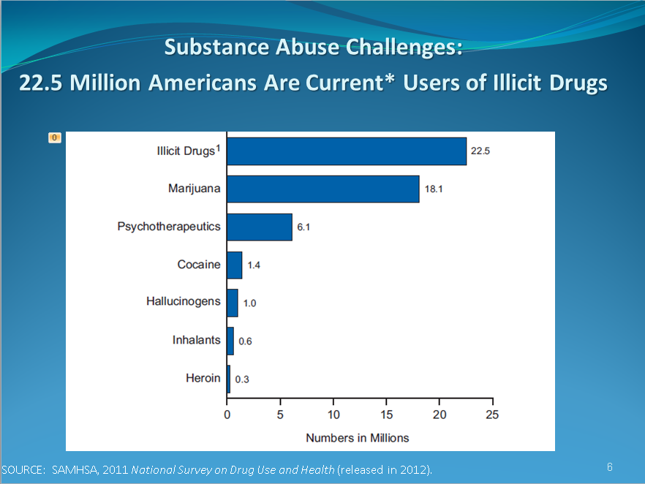

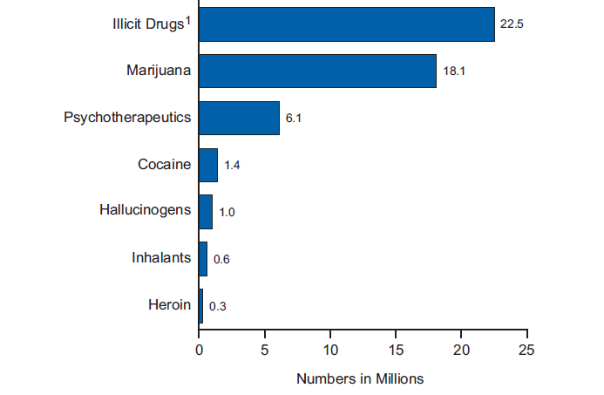
Substance Abuse Challenges:
22.5 Million Americans Are Current* Users of Illicit Drugs
Alcohol
51.8% →
SOURCE: SAMHSA, 2011 National Survey on Drug Use and Health (released in 2012).
Notes:
Nearly 20 million people reported past-month use of an illicit drug.
Marijuana ranked first in past-month use; non-medical use of prescription drugs ranked second. For the past two years, similar numbers of people initiated use of marijuana and non-medical use of prescription drugs.

Slide 7

American College of Surgeons: Committee on Trauma
The trauma center needs a mechanism to identify patients who are problem drinkers: Level I and II Trauma Centers
The trauma center has the capability to provide an intervention for patients identified as problem drinkers: Level I Trauma Centers

Slide 8
What is SBIRT?
SBIRT is a comprehensive, integrated, public health approach to the delivery of early intervention and treatment services
For persons with substance use disorders
Those who are at risk of developing these disorders
Primary care centers, trauma centers, and other community settings provide opportunities for early intervention with at-risk substance users
Before more severe consequences occur

Slide 9
SBIRT Goals
Increase access to care for persons with substance use disorders and those at risk of substance use disorders.
Foster a continuum of care by integrating prevention, intervention, and treatment services.
Improve linkages between health care services and alcohol/drug treatment services.
Notes:
Let’s review a few key terms.
1. Screening is a brief method of identifying individuals at risk for potential substance use related problems by asking them a few validated questions. Screening is a population-based approach to increase safety of individuals and populations.
2. Brief interventions consist of short-term, low-intensity counseling. Most brief interventions are 1 or 2 sessions that may last 10-20 minutes. The goal of a brief intervention is to raise awareness of substance use risks and to move people to a place where they can draw a connection between their substance use and the concerns that they come to us with.
3. Brief treatments include more in-depth counseling, typically cognitive behavioral therapy for people who are experiencing substance use related problems and would like help managing, reducing, or stopping their substance use.
4. Lastly, referrals are a set of procedures that we use to help patients access and receive services through a specialized care provider such as an addiction treatment program.

Slide 10
SBIRT: Review of Key Terms
Screening: Very brief set of questions that identifies risk of substance use related problems.
Brief Intervention: Brief counseling that raises awareness of risks and motivates client toward acknowledgement of problem.
Brief Treatment: Cognitive behavioral work with clients who acknowledge risks and are seeking help.
Referral: Procedures to help patients access specialized care.
Notes:
Let’s review a few key terms.
1. Screening is a brief method of identifying individuals at risk for potential substance use related problems by asking them a few validated questions. Screening is a population-based approach to increase safety of individuals and populations.
2. Brief interventions consist of short-term, low-intensity counseling. Most brief interventions are 1 or 2 sessions that may last 10-20 minutes. The goal of a brief intervention is to raise awareness of substance use risks and to move people to a place where they can draw a connection between their substance use and the concerns that they come to us with.
3. Brief treatments include more in-depth counseling, typically cognitive behavioral therapy for people who are experiencing substance use related problems and would like help managing, reducing, or stopping their substance use.
4. Lastly, referrals are a set of procedures that we use to help patients access and receive services through a specialized care provider such as an addiction treatment program.

Slide 11
Brief Intervention Effect
Brief interventions trigger change.
A little counseling can lead to significant change, e.g., 5 min. has same impact as 20 min.
Research is less extensive for illicit drugs, but promising.
Notes:
What is the behavior change we can expect from brief interventions? We can expect reductions in use and a reduction in negative consequences related to use.
Click to animate in Bullet 1
BIs can trigger change. We can trigger change because we meet our patients in a teachable moment and motivate them to consider change.
Click to animate in Bullet 2
We know from research that brief interventions, as short as 5 minutes, can motivate people to make changes.
Click to animate in Bullet 3
There is more evidence for the impact of brief interventions on heavy drinking, but the research on illicit drugs is growing.
Click to animate in Bullet 4
For instance, a randomized study by Bernstein and colleagues found that when cocaine and heroin users seen in primary care received a brief intervention, the patients had a 50% higher odds of abstinence at follow up compared with patients who did not receive a brief intervention.

Slide 12
Goal of Brief Interventions
Awareness of problem
Motivation
Behavior
change
Presenting problem
Screening results
Notes:
Note: With this slide, you will use animation to highlight one idea at a time, starting first with the goal of behavior change, then awareness, and then motivation.
Click to animate in “Behavior change” box on far right
We know the overall goal of brief interventions is to promote positive behavior change, such as reduced consumption and reduced harm.
To reach this goal, brief interventions work to
Click to animate in “Awareness of problem” box on far left
raise individuals’ awareness of their substance use and how it impacts their lives.
Click to animate in “Motivation” box in the middle
We then work to enhance individuals’ motivation to make changes regarding substance use.
Click to animate in “Presenting Problem.”
An individual’s presenting problem can be used to raise awareness if there is a possible connection with substance use.
Click to animate in “Screening Results.”
Likewise, the screening results can also raise awareness. To achieve our objectives in the brief intervention, it is necessary to use a motivational interviewing style. We will learn how to use this style later in this workshop.

Slide 13
Substance Use Problems among Mental
Health and/or Primary Care Populations
Severe Problem Users
Hazardous & Harmful Users
Non-Users or Low Risk Users
SBIRT
SBIRT
Notes:
Note: With this slide, you will use animation to highlight one idea at a time, starting first with the goal of behavior change, then awareness, and then motivation.
Click to animate in “Behavior change” box on far right
We know the overall goal of brief interventions is to promote positive behavior change, such as reduced consumption and reduced harm.
To reach this goal, brief interventions work to
Click to animate in “Awareness of problem” box on far left
raise individuals’ awareness of their substance use and how it impacts their lives.
Click to animate in “Motivation” box in the middle
We then work to enhance individuals’ motivation to make changes regarding substance use.
Click to animate in “Presenting Problem.”
An individual’s presenting problem can be used to raise awareness if there is a possible connection with substance use.
Click to animate in “Screening Results.”
Likewise, the screening results can also raise awareness. To achieve our objectives in the brief intervention, it is necessary to use a motivational interviewing style. We will learn how to use this style later in this workshop.

Slide 14
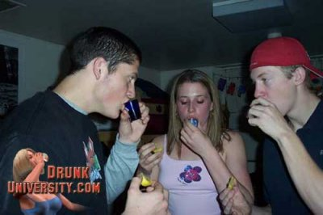
Rationale for Screening and Brief Intervention
Notes:
Note: With this slide, you will use animation to highlight one idea at a time, starting first with the goal of behavior change, then awareness, and then motivation.
Click to animate in “Behavior change” box on far right
We know the overall goal of brief interventions is to promote positive behavior change, such as reduced consumption and reduced harm.
To reach this goal, brief interventions work to
Click to animate in “Awareness of problem” box on far left
raise individuals’ awareness of their substance use and how it impacts their lives.
Click to animate in “Motivation” box in the middle
We then work to enhance individuals’ motivation to make changes regarding substance use.
Click to animate in “Presenting Problem.”
An individual’s presenting problem can be used to raise awareness if there is a possible connection with substance use.
Click to animate in “Screening Results.”
Likewise, the screening results can also raise awareness. To achieve our objectives in the brief intervention, it is necessary to use a motivational interviewing style. We will learn how to use this style later in this workshop.

Slide 15
Rationale for Screening and Brief Intervention
Substance abuse problems are widespread worldwide.
Substance use problems are associated with significant morbidity and mortality.
Early identification and intervention can help reduce substance use problems.
Notes:
What is the behavior change we can expect from brief interventions? We can expect reductions in use and a reduction in negative consequences related to use.
Click to animate in Bullet 1
BIs can trigger change. We can trigger change because we meet our patients in a teachable moment and motivate them to consider change.
Click to animate in Bullet 2
We know from research that brief interventions, as short as 5 minutes, can motivate people to make changes.
Click to animate in Bullet 3
There is more evidence for the impact of brief interventions on heavy drinking, but the research on illicit drugs is growing.
Click to animate in Bullet 4
For instance, a randomized study by Bernstein and colleagues found that when cocaine and heroin users seen in primary care received a brief intervention, the patients had a 50% higher odds of abstinence at follow up compared with patients who did not receive a brief intervention.

Slide 16

Top 10 Risk Factors for Disease Globally
Underweight
Unsafe sex
High blood pressure
Tobacco consumption
Alcohol consumption
Unsafe water, sanitation, and hygiene
Iron deficiency
Indoor smoke from solid fuels
High cholesterol
Obesity
Notes:
What is the behavior change we can expect from brief interventions? We can expect reductions in use and a reduction in negative consequences related to use.
Click to animate in Bullet 1
BIs can trigger change. We can trigger change because we meet our patients in a teachable moment and motivate them to consider change.
Click to animate in Bullet 2
We know from research that brief interventions, as short as 5 minutes, can motivate people to make changes.
Click to animate in Bullet 3
There is more evidence for the impact of brief interventions on heavy drinking, but the research on illicit drugs is growing.
Click to animate in Bullet 4
For instance, a randomized study by Bernstein and colleagues found that when cocaine and heroin users seen in primary care received a brief intervention, the patients had a 50% higher odds of abstinence at follow up compared with patients who did not receive a brief intervention.

Slide 17

Injection Drug Use and HIV
Injection drug use (IDU) has played a role in the global diffusion of HIV infection.
Globally, between 5% and 10% of HIV infections result from IDU
  In Asia and Europe, over
  70% due to IDU
IDU is the dominant mode of
transmission of hepatitis C virus
SOURCE: UNODC, 2004.
Notes:
What is the behavior change we can expect from brief interventions? We can expect reductions in use and a reduction in negative consequences related to use.
Click to animate in Bullet 1
BIs can trigger change. We can trigger change because we meet our patients in a teachable moment and motivate them to consider change.
Click to animate in Bullet 2
We know from research that brief interventions, as short as 5 minutes, can motivate people to make changes.
Click to animate in Bullet 3
There is more evidence for the impact of brief interventions on heavy drinking, but the research on illicit drugs is growing.
Click to animate in Bullet 4
For instance, a randomized study by Bernstein and colleagues found that when cocaine and heroin users seen in primary care received a brief intervention, the patients had a 50% higher odds of abstinence at follow up compared with patients who did not receive a brief intervention.

Slide 18
Problems Related to Substance Use
Acute intoxication (immediate effects from use):
Physical
  Overdose
  Fever, vomiting
Behavioral
  Accidents and injury
  Aggression and violence
  Unintended sex and unsafe sexual practices
  Reduced work performance
Notes:
What is the behavior change we can expect from brief interventions? We can expect reductions in use and a reduction in negative consequences related to use.
Click to animate in Bullet 1
BIs can trigger change. We can trigger change because we meet our patients in a teachable moment and motivate them to consider change.
Click to animate in Bullet 2
We know from research that brief interventions, as short as 5 minutes, can motivate people to make changes.
Click to animate in Bullet 3
There is more evidence for the impact of brief interventions on heavy drinking, but the research on illicit drugs is growing.
Click to animate in Bullet 4
For instance, a randomized study by Bernstein and colleagues found that when cocaine and heroin users seen in primary care received a brief intervention, the patients had a 50% higher odds of abstinence at follow up compared with patients who did not receive a brief intervention.

Slide 19
Problems Related to Substance Use
Effects of regular use include:
Specific physical and mental health problems
Increased risk for infectious diseases
Psychiatric symptoms
Sleep problems
Financial difficulties
Legal, relationship, or work problems
Risk of dependence
Withdrawal symptoms when use is reduced or stopped
Notes:
What is the behavior change we can expect from brief interventions? We can expect reductions in use and a reduction in negative consequences related to use.
Click to animate in Bullet 1
BIs can trigger change. We can trigger change because we meet our patients in a teachable moment and motivate them to consider change.
Click to animate in Bullet 2
We know from research that brief interventions, as short as 5 minutes, can motivate people to make changes.
Click to animate in Bullet 3
There is more evidence for the impact of brief interventions on heavy drinking, but the research on illicit drugs is growing.
Click to animate in Bullet 4
For instance, a randomized study by Bernstein and colleagues found that when cocaine and heroin users seen in primary care received a brief intervention, the patients had a 50% higher odds of abstinence at follow up compared with patients who did not receive a brief intervention.

Slide 20
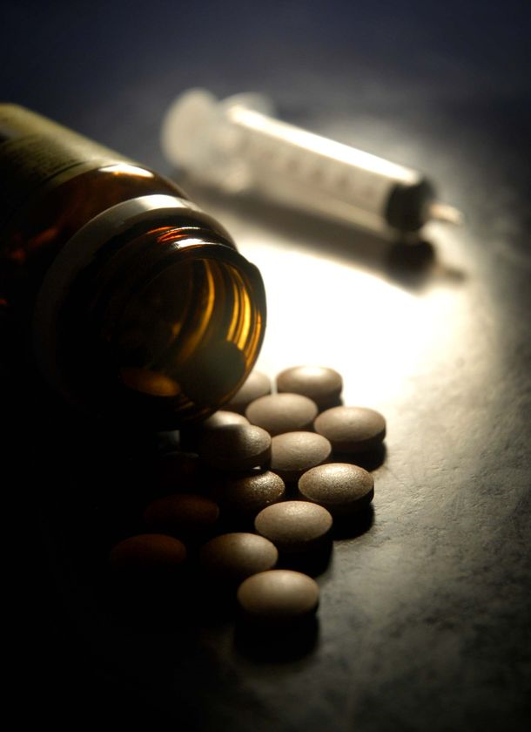

Benefits of Screening and Brief Intervention

Slide 21

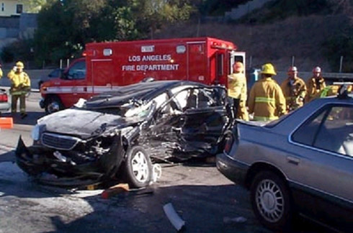

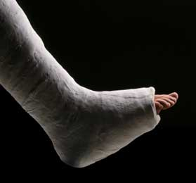
Benefits of Screening and Brief Intervention

Slide 22
Benefits of Screening and Brief Intervention
$1 Spent
Saves
$2-4

Slide 23


Benefits of Screening and Brief Intervention
Neonatal Outcomes
Work Performance

Slide 24
SBIRT for Alcohol: Major Impact of SBI on Morbidity and Mortality
Study | Results - conclusions | Reference
Trauma patients | 48% fewer re-injury (18 months) 50% less likely to re-hospitalize | Gentilello et al, 1999
Hospital ER screening | Reduced DUI arrests 1 DUI arrest prevented for 9 screens | Schermer et al, 2006
Physician offices | 20% fewer motor vehicle crashes over 48 month follow-up | Fleming et al, 2002
Meta-analysis | Interventions reduced mortality | Cuijpers et al, 2004
Meta-analysis | Treatment reduced alcohol, drug use Positive social outcomes: substance-related work or academic impairment, physical symptoms (e.g., memory loss, injuries) or legal problems (e.g., driving under the influence) | Burke et al, 2003
Meta-analysis | Interventions can provide effective public health approach to reducing risky use. | Whitlock et al, 2004

Slide 25
SBIRT for Alcohol: Saves
Healthcare Costs
Study | Cost Savings | Authors
Randomized trial of brief treatment in the UK (UKATT) | Reductions in one-year healthcare costs $2.30 cost savings for each $1.00 spent in intervention | (Hall, 2005)
Project TREAT (Trial for Early Alcohol Treatment) randomized clinical trial: Screening, brief counseling in 64 primary care clinics of nondependent alcohol misuse | Reductions in future healthcare costs $4.30 cost savings for each $1.00 spent in intervention (48-month follow-up) | (Fleming et al, 2002)
Randomized control trial of SBI in a Level I trauma center Alcohol screening and counseling for trauma patients (>700 patients). | Reductions in medical costs $3.81 cost savings for each $1.00 spent in intervention. | (Gentilello et al, 2005)
Notes:
Hall, W. (2005). British drinking: A suitable case for treatment? British Medical Journal, 331(7516), 527-528.
Fleming, MF, Mundt, MP, French, MT, Manwell, LB, Stauffacher, EA, & Barry, KL. (2002). Brief physician advice for problem drinkers: Long-term efficacy and benefit-cost analysis. Alcohol Clin Exp Res, 26, 36-43.
Gentilello, LM, Ebel, BE, Wickizer, TM, Salkever, DS, & Rivara, FP. Alcohol interventions for trauma patients treated in emergency departments and hospitals: A cost benefit analysis. Ann Surg, 241, 541-550.

Slide 26
The Key to Successful Interventions
Brief interventions are successful when clinicians relate patients’ risky substance use to improvement in patients’ overall health and well-being.
Notes:
As I mentioned before, the goal of the brief intervention is to help the patient or client to see a connection between their use and their health and wellbeing.

Slide 27
Distribution of Alcohol
(or Drug) Problems
Severe
Mild
None
Substantial
Moderate
Specialized
Treatment
Brief
Intervention
Prevention

Slide 28
2M people (0.8%) receiving treatment*
21M people (7%) have problems
needing treatment, but not receiving it*
≈ 60-80M people (≈20-25%)
using at risky levels
US Population:
307,006,550
US Census Bureau, Population Division
July 2009 estimate
28
*NSUDH, 2008

Slide 29
In treatment (2 Million)
Diagnosable problem with substance use
Referred to treatment by:*
  Self/Family 37%
  Criminal Justice 25% Other SUD Program 8%
  County Assessment Center 19% Healthcare 3%
  Other 8%
Healthcare 3%
29
*Los Angeles County Data

Slide 30
In need of treatment (21 Million)
Reported problems associated with use
Not in treatment currently
  1.1% Made an effort to get treatment
  3.7% Felt they needed treatment, but made no effort to get it.
  95.2% Did not feel that they needed treatment
Conclusion: The vast majority of people with a diagnosable illicit drug or alcohol disorder are unaware of the problem or do not feel they need help.
30

Slide 31
Using at risky levels (60-80 Million)
Do not meet diagnostic criteria
Level of use indicates risk of developing a problems.
Some examples…
These people need services,
but will
never enter
the treatment system
Drinks 3-4 glasses of wine a few times per week
Pregnant woman occasionally has a shot of vodka to relieve stress
Adolescent smokes marijuana with his friends on weekends
Occasionally takes one or two extra Vicodin to help with pain
31

Slide 32
Implications
As long as specialty care programs (SUD treatment programs) are the only places which address SUD:
Most people with severe problems will not receive treatment
Virtually all people with risky use will not receive professional attention
Notes:
What is the behavior change we can expect from brief interventions? We can expect reductions in use and a reduction in negative consequences related to use.
Click to animate in Bullet 1
BIs can trigger change. We can trigger change because we meet our patients in a teachable moment and motivate them to consider change.
Click to animate in Bullet 2
We know from research that brief interventions, as short as 5 minutes, can motivate people to make changes.
Click to animate in Bullet 3
There is more evidence for the impact of brief interventions on heavy drinking, but the research on illicit drugs is growing.
Click to animate in Bullet 4
For instance, a randomized study by Bernstein and colleagues found that when cocaine and heroin users seen in primary care received a brief intervention, the patients had a 50% higher odds of abstinence at follow up compared with patients who did not receive a brief intervention.

Slide 33
General Signs of Adolescent SUDs
Declining academic performance
Tardiness to school or outright truancy
Irritability/mood lability; aggressive outbursts
Giving up usual activities/hobbies
Change in peer group; hesitance to introduce new friends
Theft from family
Secretive behavior

Slide 34
General Signs of Adolescent SUDs
Declining motivation
Forgetfulness
Change in sleeping habits
Depression, anxiety, etc.

Slide 35

Locations for Routine Screening
Primary care settings
Emergency rooms/trauma centers
Prenatal clinics/OB-GYN offices
Medical specialty settings for
diabetes, liver, and kidney
disease/transplant programs
Pediatrician offices
College health centers
Mental health settings
Infectious disease clinics
Drinking driver programs
Notes:
What is the behavior change we can expect from brief interventions? We can expect reductions in use and a reduction in negative consequences related to use.
Click to animate in Bullet 1
BIs can trigger change. We can trigger change because we meet our patients in a teachable moment and motivate them to consider change.
Click to animate in Bullet 2
We know from research that brief interventions, as short as 5 minutes, can motivate people to make changes.
Click to animate in Bullet 3
There is more evidence for the impact of brief interventions on heavy drinking, but the research on illicit drugs is growing.
Click to animate in Bullet 4
For instance, a randomized study by Bernstein and colleagues found that when cocaine and heroin users seen in primary care received a brief intervention, the patients had a 50% higher odds of abstinence at follow up compared with patients who did not receive a brief intervention.

Slide 36
Activity: Adoption of SBIRT
How will SBIRT work in your setting?
Form a group of 2-3; Identify 1-2 barriers and 1-2 facilitators of SBIRT adoption within in your work setting
Notes:
I would now like for you to identify the barriers and facilitators you may face when implementing SBIRT in your practice. Try to identify 1 or 2 barriers and 1 or 2 facilitators (i.e., resources or aspects of your practice that would support the use of SBIRT).
Form pairs; you will have 3 minutes for this discussion.
Allow 3 minutes and then ask the audience to share their ideas.
Ok, let’s hear what you came up with for barriers.
Use newsprint or a whiteboard to document barriers and facilitators as participants identify them. Post the newsprint on the walls for the remainder of the training.
How about facilitators?

Slide 37

Screening to Identify Patients At Risk for
Substance Use Problems
Notes:
Now we are going to move into talking about screening tools, and we will practice using a brief screening tool for alcohol use.

Slide 38
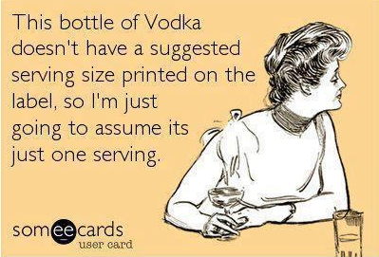
What is a Standard Drink?

Slide 39
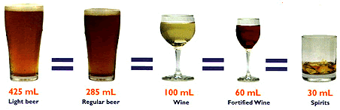
Drinking Guidelines
Men: No more that 4 drinks on any day and 14 drinks per week
Women: No more than 3 drinks on any day and 7 drinks per week
Men and Women >65: No more than 3 drinks
on any day and 7 drinks per week
NIAAA, 2011
285 ml 100 ml 60 ml 30 ml
Beer Wine Fortified Wine Liquor
12 oz 5 oz 3.5 oz 1.5 oz
Notes:
Drinking Guidelines
[Slide 5] Special concerns arise when developing alcohol consumption guidelines for the older adult population. Compared with younger people, older adults have an increased sensitivity to alcohol, as well as to over-the-counter and prescription medications. There is an age-related decrease in lean body mass versus total volume of fat. The resultant decrease in total body volume increases the circulating distribution of alcohol and other mood-altering chemicals in the body. Liver enzymes that metabolize alcohol and certain other drugs become less efficient with age. Central nervous system sensitivity increases with age.
As stated before, the potential interaction of medications and alcohol is a particular concern in this age group. For some individuals, ANY alcohol use with specific over-the-counter or prescription medications can be problematic. Because of the age-related changes in how alcohol is metabolized, and the potential interactions between medications and alcohol, alcohol use recommendations for older adults are lower than those for adults under 65. For example, the National Institute on Alcohol Abuse and Alcoholism (NIAAA, 1995b) and the CSAT Treatment Improvement Protocol (TIP) on older adults (Blow, CSAT, 1998b) recommend that persons age 65 and older consume no more than one standard drink per day or seven standard drinks per week (Dufour & Fuller, 1995; Dietary Guidelines Advisory Committee, 2000, page 39). In addition, older adults should not consume more than 2 standard drinks on any drinking day. It is recommended that the limit for older women should be slightly less than one standard drink per day.
People have different personal definitions of what exactly constitutes an alcoholic “drink.” The National Institute on Alcohol Abuse and Alcoholism has developed a definition of a standard drink. A standard drink can be a 12 ounce beer, 8-9 ounces of malt liquor, 5 ounces of wine, 3-4 ounces of fortified wine, 2-3 ounces of cordial, 1.5 ounces of brandy, or 1.5 ounces of spirits such as vodka, gin, or scotch. So, a drink for one person may be a “40-ouncer” of beer, which, if you use NIAAA’s definition of a standard drink, would equal 3 1/3 standard drinks. It is very important for alcohol dependent clients to understand what is meant by “a drink” when you are assessing the extent of their alcohol problem.

Slide 40

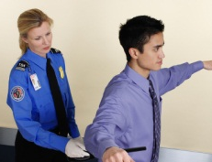
What’s going on in these pictures?
Assessment
Screening
Notes:
Click to animate in first picture
What’s going on in this picture?
Allow audience to make comments.
Click to animate the word “screening”
Like screening at the airport, our goal with substance use screening is safety. To make a difference at a population level, substance use screening needs to be universal or given to everyone.
Click to animate in second picture
So, why do we have to pat down this guy?
Allow audience to make comments.
Click to animate the word “assessment”
One reason could be that an alarm went off. When screening indicates the possibility of a problem, a provider must follow up by assessing for a potential threat to safety. In the airport, we want to know if he has a bomb; in our program, we want to know if his substance use is risky or if he could have severe problems.

Slide 41
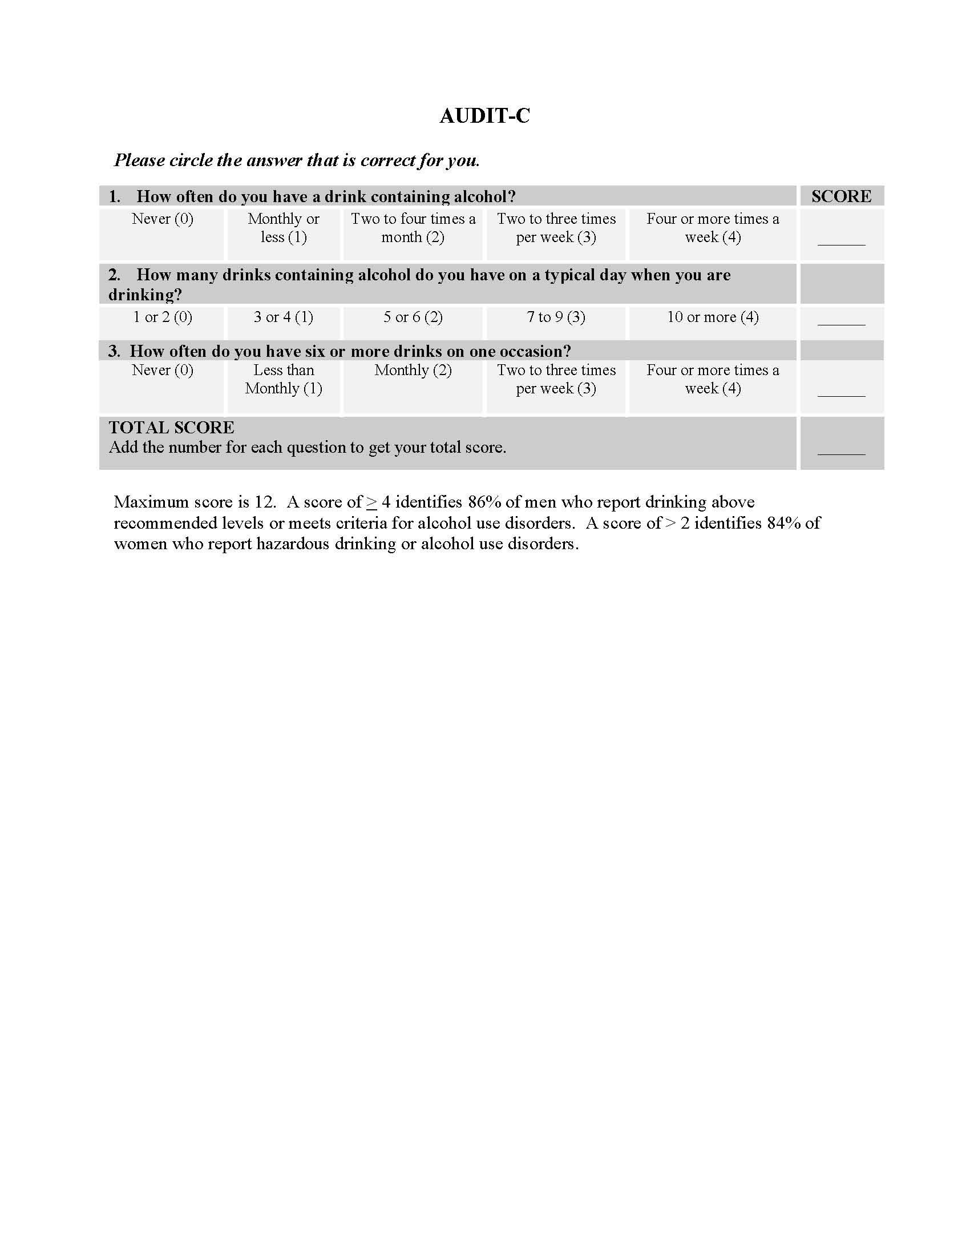
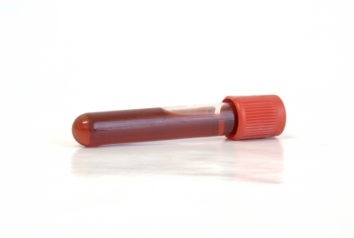
Types of Screening Tools
Self-report
  Interview
  Self-administered questionnaires
Biological markers
  Breathalyzer testing
  Blood alcohol levels
  Saliva or urine testing
  Serum drug testing
Notes:
Self-report: Most of the time when we talk about alcohol and drug screening in primary care or mental health, we are referring to short questionnaires with a maximum of 10 questions. We call these questionnaires self-report because they are based on what patients tell us. Does anyone recall filling out a few questions about alcohol and drug use the last time you saw your primary care physician? Do any of you already use screening questionnaires in your practice?
Allow responses.
Biological markers: There are also biological markers such as breathalyzers, blood alcohol concentration tests, urine testing, etc. Blood alcohol concentration tests are the most common biological marker used in medical settings. For example, in the UCLA trauma department, every patient who comes in gets a BAC test. The department also later does a self-report questionnaire after patients are stabilized. Having biological information can be very useful, but it only tells us about very recent use. In addition, biological information do not indicate how problematic an individual’s substance use may be.
Note: Biological markers can detect recent use of drugs such as cocaine, opioids, cannabis, benzodiazepines, and barbiturates. Common tests for substance use are blood, urine, and hair tests.

Slide 42
Characteristics of a Good
Screening Tool
  Brief (10 or fewer questions)
  Flexible
  Easy to administer, easy for patient
  Addresses alcohol and other drugs
  Indicates need for further assessment or intervention
  Has good “sensitivity” and “specificity”
Notes:
The best screening tools are those that are very brief, easy to use, address alcohol, illicit drugs, and prescription medications, tell us whether further assessment is needed, and have good sensitivity and specificity. Sensitivity refers to the ability of a test to correctly identify those people who actually have a problem, in other words, “true positives.” Specificity is a test’s ability to identify people who do not have a problem—“true negatives.” Good screening tools maximize sensitivity and reduce “false positives.” Self-report screens allow for more contextual information about the frequency and quantity of use. They are inexpensive, non-invasive, and highly sensitive for detecting substance use related problems.

Slide 43
Sensitivity and Specificity
  Sensitivity refers to the ability of a test to correctly identify those people who actually have a problem, e.g., “true positives”
  Specificity is a test’s ability to identify people who do not have a problem, e.g., “true negatives”
  Good screening tools maximize sensitivity and reduce “false positives”
Notes:
The best screening tools are those that are very brief, easy to use, address alcohol, illicit drugs, and prescription medications, tell us whether further assessment is needed, and have good sensitivity and specificity. Sensitivity refers to the ability of a test to correctly identify those people who actually have a problem, in other words, “true positives.” Specificity is a test’s ability to identify people who do not have a problem—“true negatives.” Good screening tools maximize sensitivity and reduce “false positives.” Self-report screens allow for more contextual information about the frequency and quantity of use. They are inexpensive, non-invasive, and highly sensitive for detecting substance use related problems.

Slide 44
Screen | Target Population | # Items | Assessment | Setting (most common) | Type
ASSIST (WHO) | -Adults -Validated in many cultures and languages | 8 | Hazardous, harmful, or dependent drug use (including injection drug use) | Primary Care | Interview
AUDIT (WHO) | -Adults and adolescents -Validated in many cultures and languages | 10 | Identifies alcohol problem use and dependence. Can be used as a pre-screen to identify patients in need of full screen/brief intervention | -Different settings -AUDIT C- Primary Care (3 questions) | Self-admin, Interview, or computerized
DAST-10 | Adults | 10 | To identify drug-use problems in past year | Different settings | Self-admin or Interview
CRAFFT | Adolescents | 6 | To identify alcohol and drug abuse, risky behavior, & consequences of use | Different settings | Self-admin or interview
CAGE | Adults and youth >16 | 4 | -Signs of dependence, not risky use | Primary Care | Self-admin or Interview
TWEAK | Pregnant women | 5 | -Risky drinking during pregnancy. Based on CAGE. -Asks about number of drinks one can tolerate, alcohol dependence, & related problems | Primary Care, Women’s organizations, etc. | Self-admin, Interview, or computerized
Notes:
Here is a chart that provides information on 6 different screening tools. Some are very broad in scope like the ASSIST, which covers alcohol, tobacco, and illicit drugs. Others are very specific like the TWEAK, which was developed for use with pregnant women and only assesses alcohol use. Has anyone heard of any of these? Which ones?
Allow 1 or 2 minutes for discussion.
For those of you who work on college campuses, I’d like to mention that you may be interested in looking at the CRAFFT, which was developed for adolescents and has been used with college students.
In this training, we will focus on the AUDIT (the Alcohol Use Disorders Identification Test). We chose to focus on the AUDIT for this training because it is the most common screening tool used in SBIRT programs in the U.S. It is straightforward, quick, and can be administered as an interview or by questionnaire. The AUDIT only covers alcohol. A commonly used screen for illicit drugs is the Drug Abuse Screening Test or the DAST. You can access all of these screens online.

Slide 45
Menu of Screening Tools
BAC/Drug Screen (biological measures)
Pre-Screens (1 question)
CAGE (4 questions)
CRAFFT (6 questions)
DAST (10 questions)
AUDIT (10 questions)
AUDIT-C+ (5 questions)
ASSIST (8 questions for each substance used)

Slide 46
Screening Tools
BAC/Drug Screen
Pre-Screens
CAGE
CRAFFT
DAST
AUDIT
AUDIT-C+
ASSIST

Slide 47

Benefits of Self-Report Tools
Provide historical picture
Inexpensive
Non-invasive
Highly sensitive for detecting potential problems or dependence
Notes:
Self-report screens allow for more contextual information about the frequency and quantity of use. They are inexpensive, non-invasive, and highly sensitive for detecting substance use related problems.

Slide 48
Enhancing Accuracy of Self-Report
Self-reports are more accurate when people are:
Alcohol- or drug-free when interviewed
Told that their information is confidential
Asked clearly worded, objective questions
Provided memory aides (calendars,
response cards)
Notes:
Previously, we discussed the importance of setting a non-judgmental atmosphere for screening, but there are additional tips for ensuring accuracy of self-report responses.
1. For example, if possible, interview patients when they are sober.
2. Tell patients that the information is confidential.
3. Ask clearly worded, objective questions that are free from judgment.
4. Provide memory aids such as calendars, if needed. You can also have patients look at the response options to the questions to make it easier for them to use the appropriate response categories.

Slide 49
Pre-screening
Pre-screening is a very quick approach to identifying people who need to do a longer screen and brief intervention.
  Self-report, 1-4 questions
  Biological, blood alcohol level test
Notes:
At times we may want to do something very quick with patients to identify who may benefit from additional screening. This is like when we go through the initial screening at the airport security check and when the metal detector alarm beeps. The TSA agent may then do a more thorough assessment (by searching your bags or doing a “pat down”). The idea is the same. Pre-screens identify people who are potentially at risk and help save time by not requiring a more thorough screening of everyone.
Typically, pre-screens are self-report and consist of 1 to 4 questions.

Slide 50
Pre-screening Example
NIAAA 1-item for alcohol use
“How many times in the past year have you had X or more drinks in a day?”
Identifies unhealthy alcohol use
Positive screen > 1 or more
(provide BI)
5 for men
4 for women
SOURCE: Barclay, L. (2009). Single screening question may accurately identify unhealthy alcohol use. Journal of General Internal Medicine.
Notes:
NIAAA has a single-item pre-screener for alcohol use: "How many times in the past year have you had X or more drinks in a day?"
X equals 5 for men and 4 for women. This pre-screen has been shown to identify unhealthy alcohol use. A positive screen is any response greater than 1 and should be followed by further screening or, in some cases, a brief intervention.

Slide 51
Pre-screening Example
NIDA 1-item for illicit drug use
"How many times in the past year have you used an illegal drug or used a prescription medication for non-medical reasons?”
Identifies overall drug use
Positive screen = 1 or more
SOURCE: Barclay, L. (2010). Single screening question may identify drug use in primary care. Archives of Internal Medicine, 170: 1155-160.
Notes:
There is a parallel validated pre-screening question for illicit drug use: "How many times in the past year have you used an illegal drug or used a prescription medication for non-medical reasons?” A score of 1 or more is considered a positive result and should trigger more in-depth screening and possibly a brief intervention.
Pose the following question in neutral, matter-of-fact way; you want to get people thinking:
What is the safe limit for drugs, say, cocaine? How much crack is OK for people to use?
Any illicit substance use is problematic because a person is putting him or herself at risk by using them.
How easy or difficult do you think it is to identify overuse or misuse of prescription medications?
Allow a couple of responses from participants.
This can be complicated, because many people, including college students, view prescriptions as safe—and legal—because a doctor wrote a prescription for the medication to someone.

Slide 52
Screening Tools
BAC/Drug Screen
Pre-Screens
CAGE
CRAFFT
DAST
AUDIT
AUDIT-C+
ASSIST

Slide 53
CAGE Alcohol Screen
Advantages:
Well suited for medical settings where time is limited
Comprised of four easy to memorize questions
Can be administered as questionnaire or as brief interview by physicians, nurses, or other clinical staff
Has been demonstrated to be superior to other screening instruments in detecting alcohol abuse and dependence*
Limitations:
Designed for screening only and is not a diagnostic tool
Screens only for alcohol use and not other drugs
Not designed to identify risky use

Slide 54
CAGE Alcohol Screen (cont)
Have you ever:
C – felt the need to cut down your drinking?
A – felt annoyed at criticism of your drinking?
G – had guilty feelings about drinking?
E – Taken a morning eye opener?

Slide 55
CAGE: Scoring
Score Probability of Abuse/Dependence*
0 7%
1 46%
2 72%
3 88%
4 98%

Slide 56
CAGE: Score Indications
Score 1: Evidence of risk. Indicates need for further clinical investigation/assessment
Score 2 or more: Evidence of current problem. Indicates need for further clinical investigation/assessment and/or referral.
Score 3 or more: Evidence of dependence until ruled out. Evaluate, treat or referral as indicated

Slide 57
Screening Tools
BAC/Drug Screen
Pre-Screens
CAGE
CRAFFT
DAST
AUDIT
AUDIT-C+
ASSIST

Slide 58
CRAFFT Screen
The CRAFFT is a behavioral health screening tool for use with adolescents and young adults under the age of 21 and is recommended by the American Academy of Pediatrics' Committee on Substance Abuse for use with adolescents.
Consists of 6 questions developed to screen adolescents for high risk alcohol and other drug use disorders simultaneously.
Short and effective.
Meant to assess whether a longer conversation about the context of use, frequency, and other risks and consequences of alcohol and other drug use is warranted.

Slide 59
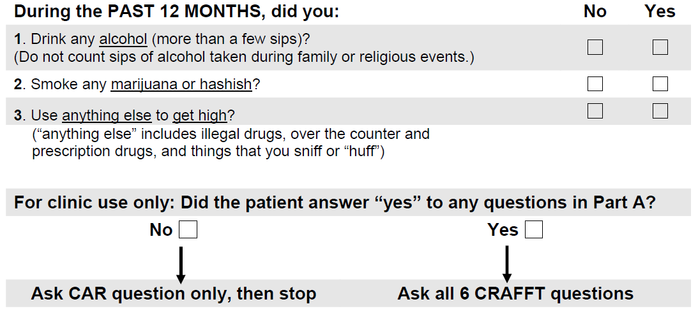
CRAFFT Part A

Slide 60
CRAFFT Part B

Slide 61
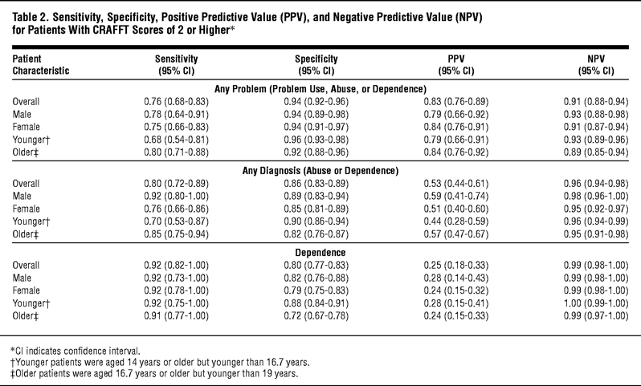
More on the CRAFFT
Knight JR, Sherritt L, Shrier LA, et al. (2002). Validity of the CRAFFT substance abuse screening test among adolescent clinic patients. Arch Pediatr Adolesc Med 156(6), 607-14.

Slide 62
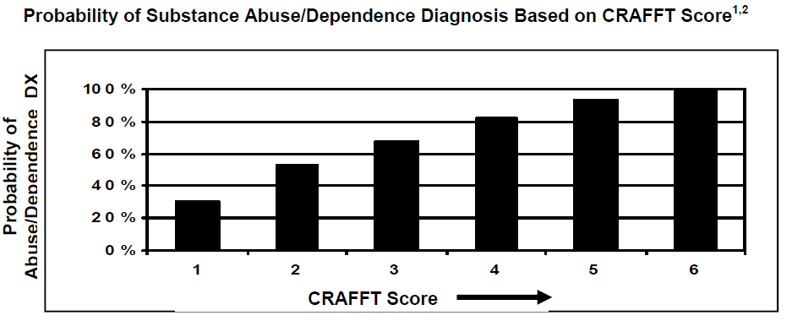
CRAFFT: Scoring
Knight JR, Sherritt L, Shrier LA, et al. (2002). Validity of the CRAFFT substance abuse screening test among adolescent clinic patients. Arch Pediatr Adolesc Med 156(6), 607-14.

Slide 63
CRAFFT: Score Indications
Score of 0: No Evidence of risk.
Score of 1 or more: Positive screen; indicates need for further assessment.

Slide 64
Screening Tools
BAC/Drug Screen
Pre-Screens
CAGE
CRAFFT
DAST
AUDIT
AUDIT-C+
ASSIST

Slide 65
Drug Abuse Screening Test – DAST
Advantages:
Brief and inexpensive
Provides a quantitative index of the extent of problems related to drug abuse
Can be administered to adults as well as adolescents
Can be administered as questionnaire or interview

Slide 66
Drug Abuse Screening Test – DAST
Limitations:
Does not screen for alcohol use/abuse
Clients may fake results
Scores may be misinterpreted
Should NOT be administered to persons actively under the influence of drugs or who are undergoing drug withdrawal reaction
Notes:
A low score does not mean that a patient is free of drug-related problems. One must take into consideration the length of time the patient has been using, level of consumption, and other data collected to assist in score interpratation.

Slide 67
Review of the DAST-10
Ten questions concerning involvement with drugs during the past 12 months
“Drug use” in the questions may refer to the use of illicit drugs as well as the misuse of prescribed or over-the-counter medications
Every question must be answered

Slide 68
Scoring the DAST-10
For questions 1 & 2, score “1” for every “YES” response
For question 3, score “1” for a “NO” response
For questions 4-10, score “1” for every “YES” response

Slide 69
DAST Interpretation Guide
Score Action Level of Problem
0 Monitor None
1-2 BI Low Risk
3-5 BI with follow-up Moderate Risk
6-8 BI/Referral Substantial Risk
9-10 BI/Referral Severe Risk
Notes:
ASAM = American Society of Addiction Medicine Placement Criteria

Slide 70
DAST Practice
Role Play: In groups of 2 (clinician and client), keep the following case in mind while completing the DAST form* on “Alex Jones”:
19 year old college freshman
Uses prescription opioids and stimulants “occasionally”
Starting to develop signs of dependence
Experiencing recent difficulties with focusing on coursework and preparing for final exams
*Refer to scored DAST-10

Slide 71
Screening Tools
BAC/Drug Screen
Pre-Screens
CAGE
CRAFFT
DAST
AUDIT
AUDIT-C+
ASSIST

Slide 72
Review of the AUDIT
10-question alcohol use screening instrument
Designed for primary health care workers; mental health care workers
Notes:
The Alcohol Use Disorders Identification Test or AUDIT was developed in the 1980s to identify alcohol use, abuse, and possible dependence. The AUDIT has 10 questions. It has been validated for use with diverse groups of people. It was originally designed for use in primary care settings, but can be used in mental health and college/university campus settings, as well.

Slide 73
Domains: Hazardous
1. How often do you have a drink containing alcohol?
(0) Never (Skip to Questions 9-10)
(1) Monthly or less
(2) 2 to 4 times a month
(3) 2 to 3 times a week
(4) 4 or more times a week
2. How many drinks containing alcohol do you have on a typical day when you are drinking?
(0) 1 or 2
(1) 3 or 4
(2) 5 or 6
(3) 7, 8, or 9
(4) 10 or more
3. How often do you have six or more drinks on one occasion?
(0) Never
(1) Less than monthly
(2) Monthly
(3) Weekly
(4) Daily or almost daily

Slide 74
Domains: Dependence
4. How often during the last year have you found that you were not able to stop drinking once you had started?
(0) Never
(1) Less than monthly
(2) Monthly
(3) Weekly
(4) Daily or almost daily
5. How often during the last year have you failed to do what was normally expected from you because of drinking?
(0) Never
(1) Less than monthly
(2) Monthly
(3) Weekly
(4) Daily or almost daily
6. How often during the last year have you been unable to remember what happened the night before because you had been drinking?
(0) Never
(1) Less than monthly
(2) Monthly
(3) Weekly
(4) Daily or almost daily
Notes:
Salience: increased importance

Slide 75
Domains: Harmful
7. How often during the last year have you needed an alcoholic drink first thing in the morning to get yourself going after a night of heavy drinking?
(0) Never
(1) Less than monthly
(2) Monthly
(3) Weekly
(4) Daily or almost daily
8. How often during the last year have you had a feeling of guilt or remorse after drinking?
(0) Never
(1) Less than monthly
(2) Monthly
(3) Weekly
(4) Daily or almost daily
9. Have you or someone else been injured as a result of your drinking?
(0) No
(2) Yes, but not in the last year
(4) Yes, during the last year
10. Has a relative, friend, doctor, or another health professional expressed concern about your drinking or suggested you cut down?
(0) No
(2) Yes, but not in the last year
(4) Yes, during the last year

Slide 76
Scoring the Audit
Score | Level | Action
0-7 | Low | Encouragement
8-19 | Low/Moderate | BI
16-19 | Moderate | BI/RT
20+ | High | BT/RT
Notes:
Like most screens, the AUDIT gives you a score. Take a minute with your partner and add up the score from your run-through. Looking at this slide, you can see how the scores correlate to risk levels (low, moderate, and high).
For example, a score of 0 to 7 is considered low risk and the appropriate response from the provider is to tell the patient he/she is at low risk, which is great. They should then encourage them to continue these low-risk behaviors.
Scores between 8 and 19 suggests low to moderate risk. People in this risk range should receive a brief intervention focused on lowering their risk.
People at the higher end of the moderate risk range—people who score 16 to 19—should be given a brief intervention and possibly the opportunity for brief treatment, which means additional counseling sessions. Again the goal is to help them to identify strategies to lower their risk of developing problems.
A person at the very high end, with a score of 20 or higher, may have alcohol dependence. This person needs a referral to specialized care. A brief intervention should be conducted, but now the focus should be on helping the person to choose to accept and follow through on a referral to treatment.

Slide 77
Activity: AUDIT Practice
Role Play: In groups of 2 (switch roles from DAST role play), keep the following case in mind while completing the AUDIT form* on Chris Sanchez:
22 year old college senior
Drinks regularly; has a hard time saying no when invited to parties on school nights
Places herself in dangerous situations by going with people she does not really know well, and has been a victim of sexual assault on one occasion
Has not been able to maintain grades or find consistent part-time work
Visits student psychological services on campus once in a while to discuss depression and anxiety.
*Refer to scored AUDIT

Slide 78
Screening Tools
BAC/Drug Screen
Pre-Screens
CAGE
CRAFFT
DAST
AUDIT
AUDIT-C+
ASSIST

Slide 79
Alcohol Use Disorders Identification Test- Consumption (AUDIT-C+)
Advantages:
Brief, only five questions
Screens for both alcohol and drug use
Scoring is fast and easy to understand
Limitations:
While the AUDIT-C has been validated, the AUDIT-C+ has not
Positive scores require further evaluation

Slide 80
Alcohol Use Disorders Identification Test- Consumption (AUDIT-C+)
How often did you have a drink containing alcohol in the past year?
___ Never (0 points)
___ Monthly or less (1 point)
___ 2 to 4 times a month (2 points)
___ 2 to 3 times a week (3 points)
___ 4 to 5 times a week (4 points)
___ 6 or more times a week (6 points)
How many drinks did you have on a typical day when you were drinking in the past year? (check one)
___ 0 drinks (0 points)
___ 1 to 2 drinks (1 point)
___ 3 to 4 drinks (1 point)
___ 5 to 6 drinks (2 points)
___ 7 to 9 drinks (3 points)
___ 10 or more drinks (4 points)

Slide 81
Alcohol Use Disorders Identification Test- Consumption (AUDIT-C+)
How often did you have 5 or more drinks on one occasion in the past year?
___ Never (0 points)
___ Less than monthly (1 point)
___ Monthly (2 points)
___ Weekly (3 points)
___ Daily or almost daily (4 points)
Have you used any drug in the past year that was not prescribed by a doctor (for example, marijuana, hash, cocaine, heroin, speed, diet pills, ecstasy, valium, LSD, acid, mushrooms, codeine, or other)?
___ No (0 points)
___ Yes (5 points)
In your lifetime, have you ever injected a drug for non-medical purposes?
___No (0 points)
___Yes (5 points)

Slide 82
Alcohol Use Disorders Identification Test- Consumption (AUDIT-C+)
TOTAL SCORE:________
Positive Screen = 5 or more points for men and 4 or more for women (for alcohol scores 1, 2, and 3) and/or a “YES” for both men and women on either Question 4 or 5.

Slide 83
Screening Tools
BAC/Drug Screen
Pre-Screens
CAGE
CRAFFT
DAST
AUDIT
AUDIT-C+
ASSIST

Slide 84
Alcohol, Smoking, and Substance Involvement Screening Test (ASSIST)
The ASSIST….
Brief screening questionnaire developed for primary care
Covers all psychoactive substances including alcohol, tobacco, and illicit drugs
Helps practitioners to identify patients who may have hazardous, harmful, or dependent use of one or more substances.
Notes:
The ASSIST is the Alcohol, Smoking and Substance Involvement Screening Test. It is a brief screening questionnaire to find out about people’s use of psychoactive substances. It was developed by the WHO and an international team of substance use researchers as a simple method of screening for hazardous, harmful and dependent use of alcohol, tobacco and other psychoactive substances.
The ASSIST is the first screening test which covers all psychoactive substances including alcohol, tobacco and illicit drugs, and can help practitioners identify patients who may have hazardous, harmful or dependent use of one or more substances.
Hazardous use is a pattern of psychoactive substance use which increases the risk of harmful consequences for the user.
Harmful use is a pattern of psychoactive substance use that is damaging to the physical and or mental health of the user.
Dependence on alcohol or other drugs usually develops after repeated use and involves a cluster of symptoms which may include a strong desire to use the substance, impaired control over its use, persistent use of the substance even when it is causing harm, increased tolerance to the effects of the substance and a withdrawal reaction when use is stopped or reduced.
Hazardous, harmful or dependent use patterns of psychoactive substances can also cause significant social problems for the user, such as problems with family, friends, the law and finances (WHO, 2003a).

Slide 85
ASSIST Development
Developed by an international research team in 1997
Funded by WHO and the Australian Commonwealth Dept. of Health and Ageing
  Coordinated by Drs. Robert Ali and Rachel Humeniuk of the Drug & Alcohol Services South Australia (DASSA)
Based on the AUDIT model of screening & brief intervention for alcohol (also sponsored by WHO)
Source: WHO, 2002b & WHO, 2003a
Notes:
The ASSIST was designed specifically for international use in primary care settings to identify:
• those whose patterns of substance use put them at risk of problems,
• those who have already developed problems related to their substance use,
• those at risk of developing dependence (WHO, 2003a).

Slide 86
ASSIST Development
Phase I (1997-1999; 236 subjects)
  Planning and ASSIST development; international feasibility and reliability study
  Study conducted at sites in Australia, Brazil, Ireland, India, Israel, the Palestinian Territories, Puerto Rico, the United Kingdom, & Zimbabwe
ASSIST items were reliable, and ASSIST procedure was feasible in primary care settings
Notes:
ASSIST Technical report which describes phase 1 and phase 2 studies is available at http://www.who.int/substance_abuse/activities/assist/en/

Slide 87
ASSIST development (3)
Phase II (2000-2002, 1,047 subjects)
  International validity study of the ASSIST; feasibility study of brief interventions linked to the ASSIST
  Conducted internationally at 7 sites
ASSIST provides a valid measure of substance-related risk
ASSIST distinguishes between individuals who are at low risk or are abstainers, risky/problem users, or dependent

Slide 88

In general, the ASSIST provides information about:
Substances used in the patient’s lifetime
Substances used in the previous 3 months
Problems related to substance use
Risk of current or future harm
Dependence
Injecting drug use
Notes:
The ASSIST can help warn people that they may be at risk of developing problems related to their substance use in the future and it can provide an opportunity to start a discussion with a client about their use. It can identify substance use as a contributing factor to the presenting illness.
The ASSIST can be linked to a brief intervention to help high risk substance users cut down or stop their use and so avoid the harmful consequences of their use (WHO, 2003a).

Slide 89
ASSIST
Learning to Use the ASSIST Screening Tool
Notes:
For most people, the ASSIST can be completed in about five or ten minutes and can be incorporated into the normal consultation (WHO, 2003a).
Ask participants to look at their copy of the ASSIST so that they can follow along as you review the questions.

Slide 90
Introducing the ASSIST (1)
Use a non-confrontational approach
Describe the purpose of the screening
  “Many drugs and medications can affect your health. It is important for me to have accurate information about your use of various substances in order to provide the best possible care.”
Emphasize the time frame
  “The following questions ask about your experience of using alcohol, tobacco products, and other drugs across your lifetime and in the past 3 months.”
Source: McGree, 2005
Notes:
The ASSIST should be introduced carefully with a brief explanation of the reasons for asking and instructions for responding. The ASSIST questionnaire comes with a card which a list of the drugs covered by the questionnaire, and a list of appropriate responses for each question. For patients whose drug use is prohibited by law, culture or religion it may be necessary to acknowledge the prohibition and encourage honest responses about actual behaviour. “I understand that others may think you should not use alcohol or other drugs at all but it is important in assessing your health to know what you actually do.” (WHO, 2003a).

Slide 91
Introducing the ASSIST (2)
Clarify the substances you will record
  “Some of the substances listed may be prescribed by a doctor. For this interview, we will not record medications that are used as prescribed by your doctor. However, if you have taken such medications for reasons other than by prescription, or taken them more frequently or at higher doses than prescribed, please let me know.”
Emphasize Confidentiality
  “While we are also interested in knowing about your use of various illicit drugs, please be assured that the information on such use will be treated as strictly confidential.”
Source: McGree, 2005
Notes:
During the introduction and instructions for the ASSIST the health worker should clarify which substances are to be covered in the interview and ensure that they are referred to by names which are familiar to the patient (WHO, 2003a).
Emphasize that the patient’s confidentiality will be maintained.

Slide 92
Response Card (Drug List)
Notes:
The Response Card for Patients contains a list of the substance categories covered by the ASSIST together with a range of names associated with each category. It also contains frequency responses for each question. The interviewer should use the most culturally appropriate names for their location. Check with patients what names they use to describe particular drugs and use the names that they use (WHO, 2003a).

Slide 93
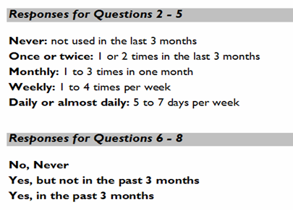
Response Card (Response Items)
Notes:
Trainer’s note:
Be sure to review the meaning of each response category, as this is one of the places where errors can occur. For example, the category “monthly” means that the substance was used a total of 3 - 9 times in total over the last 3 months (Humeniuk , 2005).

Slide 94
Question 1: Lifetime Use
In your life, which of the following substances have you ever tried?
(non-medical use only)
  No (0)
  Yes (3)
Ask for all substances
Record any use (even if only tried once)
Probe: Not even at a party?
If “No” to all substances, end the interview.
Source: Humeniuk, 2005
Notes:
Question 1 asks about lifetime use of substances, i.e., those drugs the patient has ever used, even if it is only once. Every patient should be asked this question for all the substances listed. If the patient answers ‘No’ to every substance the interviewer should ask a probing question “Not even when you were in school?”. If the response is still ‘No’ to all the substances then the interview should be stopped.
If the patient answers ‘Yes” to Question 1 for any of the substances listed then move on to Question 2 which asks about substance use in the previous three months (WHO, 2003a).

Slide 95
Question 2: Recent Use
Frequency of use in the past 3 months
During the past 3 months, how often have you used the substances you mentioned (first drug, second drug, etc)?
  Never (0)
  Once or twice (2)
  Monthly (3)
  Weekly (4)
  Daily or almost daily (6)
Notes:
(If the patient answers ‘Yes” to Question 1 for any of the substances listed then move on to Question 2 which asks about substance use in the previous three months.)
Question 2 asks about the frequency of substance use in the past three months, which gives an indication of the substances which are most relevant to current health status.
Question 2 should be asked for each of the substances ever used. If the response is ‘Never’ to all of the items in Question 2, move on to Question 6.
If any substances have been used in the past three months then continue with Questions 3, 4 and 5 for each substance used (McGree, 2005).

Slide 96
Question 3: Strong Urge to Use
Frequency of experiencing a strong desire or urge to use each substance in the past 3 months
During the past three months, how often have you had a strong desire or urge to use (first drug, second drug, etc)?
  Never (0)
  Once or twice (3)
  Monthly (4)
  Weekly (5)
  Daily or almost daily (6)
Notes:
Question 3 asks about the frequency of experiencing a strong desire or urge to use each substance in the last three months (WHO, 2003a).
This question refers to a strong desire or cravings for the drug. A high score on this question is usually associated with high risk dependent use rather than hazardous risky use. For example, if the person is a daily smoker they are likely to be experiencing these cravings daily. In this case, one could use cigarette cravings as an example when asking about cravings for other drugs. One could ask the question as follows: “You know the level of craving that you get for a cigarette - how often would you experience that level of craving for alcohol, for marijuana etc?“(Humeniuk, 2005).

Slide 97
Question 4: Health, Social, Legal, or Financial Problems
Frequency of experiencing health, social, legal or financial problems related to substance use, in the past 3 months
During the past 3 months, how often has your use of (first drug, second drug, etc.) led to health, social, legal, or financial problems?
  Never (0)
  Once or twice (4)
  Monthly (5)
  Weekly (6)
  Daily or almost daily (7)
Notes:
Question 4 asks about the frequency of health, social, legal or financial problems related to substance use in the last three months (WHO, 2003a).
It is important to provide examples of the kinds of problems that are associated with each drug. Alcohol, for example, can lead to bad hangovers, gastrointestinal problems, and/or doing things when you're drunk that you later on regret. For amphetamines, one could ask about a bad come-down where they feel depressed, anxious, and irritable. For cocaine, one could ask about irrational thoughts, anxiety, and feeling angry and irritable. Doing this helps the client to understand what you mean - for some of them it may be the first time they have realized that their use is causing them problems (Humeniuk, 2005).

Slide 98
Question 5: Failure to Fulfill Major Role Responsibilities
Frequency that each substance has interfered with role responsibilities in the past 3 months
During the past 3 months, how often have you failed to do what was normally expected of you because of your use of (first drug, second drug, etc)?
  Never (0)
  Once or twice (5)
  Monthly (6)
  Weekly (7)
  Daily or almost daily (8)
Notes:
Question 5 asks about the frequency with which use of each substance has interfered with role responsibilities in the past three months.
It should be noted that Q5 is not asked for tobacco because it is unlikely that failure to fulfil role obligations would be experienced by tobacco users.
Here again, it is important to give the client examples of what failing to fulfill role obligations means, and that normally it is indicated by consequences, e.g., missing work and getting into trouble from the boss, losing pay, failing to look after your children properly, or failing to maintain your relationship with your partner. Normally, one would not consider the occasional mild hangover to be a significant consequence, even if it involved missing one day of work (Humeniuk, 2005 & McGree, 2005 ).

Slide 99
Question 6: External Concern
Proximity of someone else’s concern, if any, about the patient’s substance use
Has a friend or relative or anyone else ever expressed concern about your use of (first drug, second drug, etc.)?
  No, Never (0)
  Yes, in the past 3 months (6)
  Yes, but not in the past 3 months (3)
Notes:
Question 6 refers to substances ever used and asks whether anyone has ever expressed concern about the patient’s use of each substance and how recently that occurred.
All patients reporting ever having used any substance in their lifetime in Question 1 should be asked Questions 6, 7 and 8. Questions 6 and 7 should be asked for each substance endorsed in Question 1 (McGree, 2005).

Slide 100
Question 7: Failed Attempts to Control Substance Use
Proximity of the patient’s failed attempts to control use
Have you ever tried and failed to control, cut down, or stop using (first drug, second drug, etc.)?
  No, Never (0)
  Yes, in the past 3 months (6)
  Yes, but not in the past 3 months (3)
Notes:
Question 7 asks whether the patient has ever tried and failed to cut down or give up their use of each substance and how recently that occurred.
Questions 6 and 7 should be asked for each substance endorsed in Question 1 (WHO, 2003a).
Question 7 tends to be the most confusing for people. It is helpful to ask the question like this: “Have you ever tried to cut down on drinking alcohol, but failed?"
Note that clients can score zero on this for 3 reasons:
1. They have never tried to cut down because it is not an issue (e.g.. only tried speed once, drink alcohol in moderation, etc.)
2. They have never tried to cut down because, even though they may be using in a risky way, they are “precontemplators.”
3. They have tried to cut down and they were successful in that attempt. If they were successful the first time they tried to cut down, they score 0. If they made several attempts to cut down and were eventually successful, then one needs to capture when the last time was that they tried and failed, and record that (Humeniuk, 2005).

Slide 101
Question 8: Injecting Drug Use
Have you ever used any drug by injection?
(non-medical use only)
  No, Never (0)
  Yes, in the past 3 months (2)
  Yes, but not in the past 3 months (1)
If yes, query about pattern of injecting:
Notes:
Question 8 is focused on injecting and asks whether the patient has ever injected any drug. Injection is treated separately because it is a particularly high risk activity associated with increased risk of dependence, blood borne viruses such as HIV and hepatitis C and with higher levels of other drug related problems (WHO, 2003a).

Slide 102
Pattern of injecting
Notes:
Patients who have injected drugs in the last 3 months should be asked about their pattern of injecting to determine their risk level and the best course for intervention (WHO, 2003a).
A general rule of thumb here is that injecting more than 4 times per month on average requires more intensive treatment (Humeniuk, 2005).

Slide 103
Scoring the ASSIST
For each substance (labelled a. to j.), add up the scores received for questions 2 through 7 inclusive. Do not include the results from either Q1 or Q8 in this score.
Question 2c | Weekly | Score = 4
Question 3c | Once or twice | Score = 3
Question 4c | Monthly | Score = 5
Question 5c | Once or twice | Score = 5
Question 6c | Yes, but not in the past 3 months | Score = 3
Question 7c | No, never | Score = 0
Substance Specific Involvement Score for Cannabis |  | 20
Notes:
Each question on the ASSIST has a set of responses to choose from, and each response has a numerical score. The interviewer simply circles the numerical score that corresponds to the patient’s response for each question. At the end of the interview these scores are added together to produce an ASSIST score.
Note: The scores are weighted – endorsement of question items get increasingly higher scores.
It should be noted that Q5 is not asked for tobacco because it is unlikely that failure to fulfil role obligations would be experienced by tobacco users.
(Note that Q5 for tobacco is not coded, and is calculated as: Q2a + Q3a + Q4a + Q6a + Q7a (WHO, 2003a).

Slide 104
Guidelines for Assessing Risk Level Using the ASSIST
Alcohol | All Other Substances | Risk Level
0-10 | 0-3 | Low Risk (Provide Education)
11-26 | 4-26 | Moderate Risk (Brief Intervention)
27+ | 27+ | High Risk (BI + Referral)
Note: Be careful! Don’t blindly interpret the score. A patient can score in the “Moderate Risk” range because of past use (i.e., answered “Yes, but not in the past 3 months” for questions 6 & 7), and may not be currently using.
Notes:
Be careful! A patient can score a 6 by answering yes to the last two “ever” questions about External Concern and failure to control use in the past. Although they still score in the “moderate risk” category, tailor your BI to acknowledge their past use (but current abstinence) (McGree, 2005).

Slide 105
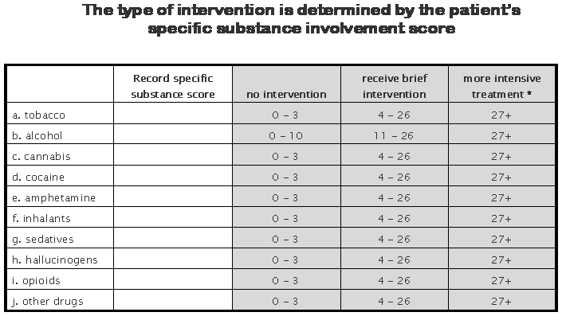
Recording the Substance Specific Involvement Score
27
10
6
0
0
0
3
0
18
0
* further assessment and more intensive treatment may be needed
Notes:
All patients screened using the ASSIST should receive feedback regarding their scores and level of risk and be offered information about the substances they use. This is the minimum level of intervention for all patients.
For patients whose ASSIST score indicates that they are at low risk of substance related harm for all substances this level of intervention is sufficient.
Patients whose ASSIST score indicates that they are at moderate risk of harm should be offered a brief intervention.
Patients whose Specific Substance Involvement score is 27 or more for any substance, and/or have regularly injected drugs in the last 3 months are likely to be at high risk and substance dependent and require more than just a brief intervention. These people require further assessment and more intensive treatment (WHO, 2003a).

Slide 106
Patient feedback form
Notes:
The ASSIST Feedback form is completed at the end of the ASSIST interview and is used to provide personalized feedback to the patient about their level of substance related risk (WHO, 2003a).

Slide 107
SBI Decision Tree
Complete Pre-Screen
Alcohol:
Women = 0 – 2
Men = 0 – 4
Alcohol:
Women = 4+
Men = 5+
Other Drugs:
Any Yes
Other Drugs:
All Nos
Alcohol Screen Complete
Administer the CRAFFT
Other Drug
Screen Complete
Low/No Risk:
Alcohol = 0 – 7
Other drugs = 0
At Risk:
Alcohol = 8 – 15
Other drugs = 1 – 2
Mod/High Risk:
Alcohol = 16 – 19
Other drugs = 3 – 5
High/Severe Risk:
Alcohol = 20 – 40
Other drugs = 6 – 10
Reinforce behavior;
Monitor
Brief Intervention
Goal: Lower Risk; Reduce use to acceptable levels
BI/Referral to tx/BT
Goal: Encourage pt. to accept a referral to tx, or engage in BT
Referral to tx.
Goal: Encourage pt. to accept referral to tx, or engage in BT
Notes:
107
Let’s look at this detailed flow chart that depicts an SBI decision tree. Imagine we start with a pre-screen. If we have a positive score on the pre-screen for alcohol or drugs, we would typically proceed to a full screen such as the AUDIT or the DAST.
It is important to note that a pre-screen is not required. There are many operational SBIRT programs that do not use a pre-screen, but rather administer a full screening with all patients.

Slide 108

Conducting a Brief Intervention requires strong MOTIVATIONAL INTERVIEWING skills
Notes:
Now we are ready to learn how to apply the key motivational interviewing concepts in a brief intervention.

Slide 109
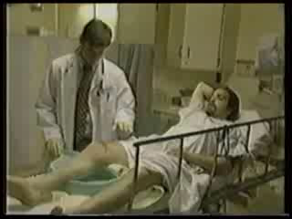
Activity: Video Example (1)
Young man is treated in the ER after a car accident. He had been drinking heavily before the accident. How does the doctor address drinking in this video?
Notes:
Note: Be sure to practice with the video ahead of time. If you have difficulty playing the video, see the trainer’s guide for alternate ways of accessing it.
We are going to watch two videos of doctors talking to a patient in an emergency room setting. The patient is a young man who had been drinking heavily and was involved in a bad car accident. These videos demonstrate different styles of talking to patients.
Hover over the video image to make the video controls appear. Click on the play button to show the “bad example” video. The video should display full screen.
Facilitate a 5-minute discussion with participants using the following questions:
What did you notice about the doctor’s approach. How did the patient react? Was it effective? Why or why not?
In the discussion, make sure that the following are covered:
Angry and judgmental tone
Telling the patient what to do
Specific judgmental statement (e.g., “I know when someone is an alcoholic and I think that you have a serious drinking problem.” “Have some common sense.”)
Finger-wagging
Patient is frustrated, defensive, and just wants to get out of there

Slide 110
What is Motivational Interviewing?
It is:
A style of talking with people constructively about reducing their health risks and changing their behavior.
Notes:
Draw from audience the kinds of changes that they would like to see individuals they know make. Inquire as to whether they have talked with them about making the changes and what the results were.

Slide 111
What is Motivational Interviewing?
It is designed to:
Enhance the client’s own motivation to change using strategies that are empathic and non-confrontational.
Notes:
Do exercise where participants work with one other person. Each person chooses a behavior they think would be helpful for them to make but that they have not yet successfully changed. Have partners take turns talking with the other person about making that change.
Instruct the convincing partner to point out all the reasons the person should change, offer suggestions for them to change, warn them about what may happen if they don’t change, etc.
Process with group how it felt to have someone interact with them in such a confrontational way. How did it make them feel about changing?

Slide 112
MI - The Spirit: Style
Nonjudgmental and collaborative
Based on consumer and clinician partnership
Gently persuasive
More supportive than argumentative
Listens rather than tells
Communicates respect and acceptance for consumers and their feelings

Slide 113
MI - The Spirit: Consumer
Responsibility for change is left with the consumer
Change arises from within rather than being imposed from without
Emphasis on consumer’s personal choice for deciding future behavior
Focus on eliciting the consumer’s own concerns

Slide 114
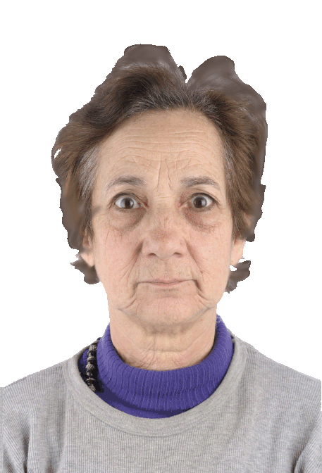







Ambivalence
  All change contains an element of ambivalence.
    We “want to change and don’t want to change”
Patients’ ambivalence about change is the “meat” of the brief intervention.
Notes:
Note: This slide contains automatic animation. As you are reviewing the bullet points the image of the woman should advance automatically to demonstrate a variety of different emotions. Participants may chuckle or become slightly distracted by the images. They are very effective in making the point about ambivalence.
The first thing to recognize with change is that we all have feelings of ambivalence.
What is ambivalence? It’s when we feel two ways about something. We may like to drink, but we also don’t like having a hangover. Exploring a person’s ambivalence about change is one way of assessing where they are in the change process.
An individual’s ambivalence about taking action is rich material that we can use as the basis for the brief intervention. If we can get an individual to talk about his or her ambivalence about making a change, we gain access into their world and can better understand their perspective.

Slide 115
How does MI differ from traditional or typical medical counseling?
AMBIVALENCE is the key issue to be
resolved for change to occur.
People are more likely to change when they hear their own discussion of their ambivalence.
This discussion is called “change talk”
in MI.
Getting patients to engage in “change talk” is a critical element of the MI process.
*Glovsky and Rose, 2008

Slide 116
How to Explore Ambivalence
The good things about ______
The not- so-good things about ____
The good things about changing
The not-so-good things about changing
Avoid questions that inspire a yes/no answer.
Notes:
The way we explore ambivalence in motivational interviewing is to ask open-ended questions.
Use pointer to direct attention to related boxes
Upper Left: For example, “What are the good things about your substance use?”
Upper Right: “What about the not-so-good things?”
Lower Left: “What would be good about using less?”
Lower Right: “What would be not so good about cutting back?”
Someone tell me if this is an open or a closed question, “Do you drink when you are alone?”
Elicit responses. Correct answer: This is a closed question.
How could you make it an open-ended question?
Suggestion: Who do you drink with on a typical day?

Slide 117
Motivational Interviewing Strategies
Use reflective listening and empathy
Avoid confrontation
Explore ambivalence
Elicit “change talk”
Notes:
Motivational interviewing strategies help raise awareness and enhance motivation. Reflective listening, showing empathy, avoiding confrontation, exploring ambivalence, and eliciting change talk are core strategies. Let’s take a look at a couple videos that demonstrate a motivational interviewing style.

Slide 118
Building Motivation OARS
(the micro-skills)
Open-ended questioning
Affirming
Reflective listening
Summarizing
Notes:
118

Slide 119
Reflective Listening
Listen to both what the patient says and to what the person means
Show empathy and don’t judge what patient says
  You do not have to agree
Be aware of intonation
  Reflect what patient says with statement not a question, e.g., “You couldn’t get up for work in the morning.”
Notes:
119
Reflective listening is one of the most important motivational interviewing micro-skills and it is essential to ensuring a successful brief intervention.
Bullet 1. Reflective listening is listening to what people say and to what they mean; it’s a means of gaining access into someone’s world. The doctor in the second video used reflective listening with his patient. He didn’t judge the patient’s comments. Instead, he reflected back what the patient was saying and feeling. For example, when the patient in the video said that he couldn’t remember what happened after leaving the bar, the doctor reflected back by stating, “So you’re having trouble remembering what happened last night. Sounds frightening.” The doctor confirmed both the stated content and the unstated feeling (fear) that the patient experienced.
Bullet 2. The doctor directly empathized with the patient several times. For example, “I can understand that. You want to enjoy yourself with friends.” What we are trying to do is create an environment of non-judgment so that patient feels comfortable being honest with us.
Bullet 3. It is important to be aware of intonation. When you reflect back what a person says and it sounds like a question, this can come off as judgmental. Try to make a statement as opposed to asking a question. For example, “You are having a lot of emotions.” Statements can be powerful, because they force people to look in the mirror and observe what is happening. Also, watch for nonverbal cues. Judgment can show on your face. If a patient says, “I didn’t feel well yesterday.” If I answer, [say this with a suspicious tone and expression] “You didn’t feel well yesterday,” my nonverbal expression of disbelief with be heard much louder than the actual words that I say. We need to watch our tone and our facial expressions so we don’t let our own feelings and judgments show.

Slide 120
Levels of Reflection
Repeating – Repeating what was just said.
Rephrasing – Substituting a few words that may slightly change the emphasis.
Paraphrasing – Major restatement of what the person said. Listener infers meaning of what was said. Can be thought of as continuing the thought.
Reflecting Feeling – Listener reflects not just the words, but the feeling or emotion underneath what the person is saying.
Notes:
There are a few different ways of doing reflective listening.
Repeating is the simplest form of a reflection, but not necessarily the most interesting. For example, if a person says, “I’m angry,” the clinician would say, “You’re angry.” Simple reflections are good for confirming understanding to content, but they do not convey understanding of deeper, more emotional meaning.
Amplified reflections are designed to highlight the emotional content of the communication. In our SBIRT example, the doctor responded to the patient’s statement that he could not remember his accident by stating, “That sounds scary.” Even though the patient never said it, the doctor introduced this emotional content using an amplified reflection and deepened his understanding of the patient.
Finally, a double-sided reflection is designed to highlight the patients ambivalence. This helps the patient see both the positive and the negative from a more objective perspective. The doctor says, “On the one hand, drinking is a way for you to relax and enjoy your time with friends…On the other hand, it makes getting up in the morning difficult…” By seeing his or her own attitudes in a new way, the individual may become more motivated to reduce the negative consequences.

Slide 121
Types of Reflective Statements
1. Simple Reflection (repeat)
Amplified Reflection (amplify/exaggerate the consumer’s point)
Double-Sided Reflection
(captures both sides of the
ambivalence)

Slide 122
Avoid Confrontation
Challenging
  “What do you think you are doing?”
Warning
  “You will damage your liver if you don’t stop drinking.”
Finger-wagging
  “If you want to be a good student, you must stop drinking on school nights.”
Notes:
Confrontation is counterproductive to enhancing people’s motivation to change. When we confront people about their substance use, we are arguing with them, or trying to convince them that they have a problem. Arguing with our patients is going to make them defensive, which is the opposite of what we want to accomplish during a brief intervention.
Bullet 1. When we confront people we can challenge them, “What do you think you are doing?”
Bullet 2. Warn them, “You are going to damage your liver.”
Bullet 3. And tell them what to do, “If you want to be a good student, you must stop drinking on school nights.”
What other types of confrontational statements could we make when talking to someone about their substance use?
Elicit a few responses from participants.
Note: Other ways of confronting someone include moralizing, giving unwanted advice, shaming, and being sarcastic.

Slide 123
Elicit “Change Talk”
Change talk consists of self-motivational statements that suggest:
Recognition of a problem
Concern about staying the same
Intention to change
Optimism about change
Notes:
Another key strategy in motivational interviewing is eliciting change talk.
Change talk consists of self-motivational statements that people make in relation to behavior change.
Bullet 1. Patients may say things that suggest they recognize the problem,
Bullet 2. have concerns about not changing,
Bullet 3. have some intention to change, and
Bullet 4. feel optimistic about their ability to make change.
When patients make these statements, they are moving in the direction of being more willing or motivated to change.

Slide 124
Moving Toward “Change Talk”: the DARN Steps
Desire
Ability
Reason
Commitment
Need

Slide 125
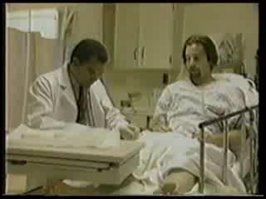
Activity: Video Example (2)
Same scenario, but different doctor. What does this doctor do that is different? Does it work?
Notes:
The second video involves the same patient but a different doctor. Let’s look at how this doctor approaches the patient.
Hover over the video image to make the video controls appear. Click on the play button to show the “good example” video. The video should display full screen.
Facilitate a 5-minute discussion with participants using the following questions:
What did you notice about the doctor’s approach? What did the doctor do that worked well? How did the patient respond?
In the discussion, make sure that the following are covered:
The doctor style was respectful, nonjudgmental, and conversational
He explored the pros and cons of his drinking
Offered reflections of emotions and content
Involved the patient in the discussion and explored options
Offered options if his strategy to cut down did not work
Was encouraging about patient’s plan
Patient was willing to engage in discussion and generated solutions for behavior change

Slide 126
What if…?
What if the client doesn’t say ANY change talk?
“Actions speak louder than words.” Do the client’s actions express any change talk? (Can you address any discrepancy between their words and their actions?)
  Client: “This program is worthless. I don’t want anything to do with it.”
  “On the one hand, you don’t really want to be here and you don’t think it will help you at all. On the other hand, you’re still sitting here in front of me. I’m wondering how that adds up.”
  Client: ?

Slide 127
What If, Continued
No, I mean it: What if the client gives you NO change talk? AT ALL?
Try reflecting the resistance. Can you get even MORE resistant than the client?
    Client: “My PO wants me working and going to counseling and TASC. You guys want me going to all these meetings, making curfew, giving you all my money. My wife is always on my case. I’m gonna have to get loaded just to deal with you all!”
    Staff: “It would be impossible to deal with all these people sober. In fact, nobody could do it!”
    Client: ?

Slide 128
What If, Continued
Consider the possibility that you are not talking about the right issue…
?
?
?
?
?
?

Slide 129
Goal of Brief Interventions
Awareness of problem
Motivation
Behavior
change
Presenting problem
Screening results
Notes:
Note: With this slide, you will use animation to highlight one idea at a time, starting first with the goal of behavior change, then awareness, and then motivation.
Click to animate in “Behavior change” box on far right
We know the overall goal of brief interventions is to promote positive behavior change, such as reduced consumption and reduced harm.
To reach this goal, brief interventions work to
Click to animate in “Awareness of problem” box on far left
raise individuals’ awareness of their substance use and how it impacts their lives.
Click to animate in “Motivation” box in the middle
We then work to enhance individuals’ motivation to make changes regarding substance use.
Click to animate in “Presenting Problem.”
An individual’s presenting problem can be used to raise awareness if there is a possible connection with substance use.
Click to animate in “Screening Results.”
Likewise, the screening results can also raise awareness. To achieve our objectives in the brief intervention, it is necessary to use a motivational interviewing style. We will learn how to use this style later in this workshop.

Slide 130
Where Do I Start?
What you do depends on where the patient is in the process of changing.
The first step is to be able to identify where the patient is coming from.
Notes:
We have to start by assessing how aware the patient is of his or her substance use and the consequences.
Click to animate first sentence.
What we do depends on where the patient is in the process of changing. Most of the time patients are coming to us for other concerns and have not thought about changing their substance use.
Click to animate second sentence.
The first step, then, is the identify where our patients are coming from. We want to know how substance use fits into people’s lives so we can understand their situation.

Slide 131
1. Precontemplation
Definition:
Not yet considering change or
is unwilling or unable to change.
Primary Task:
Raising Awareness
6. Recurrence
Definition:
Experienced a recurrence
of the symptoms.
Primary Task:
Cope with consequences and
determine what to do next
2. Contemplation
Definition:
Sees the possibility of change but
is ambivalent and uncertain.
Primary Task:
Resolving ambivalence/
Helping to choose change
Stages of Change:
Primary Tasks
5. Maintenance
Definition:
Has achieved the goals and is
working to maintain change.
Primary Task:
Develop new skills for
maintaining recovery
3. Determination
Definition:
Committed to changing.
Still considering what to do.
Primary Task:
Help identify appropriate
change strategies
4. Action
Definition:
Taking steps toward change but
hasn’t stabilized in the process.
Primary Task:
Help implement change strategies
and learn to eliminate
potential relapses
Notes:
The Stages of Change is a theoretical perspective that we can use to understand where a person is coming from in terms of their substance use. At the top in blue is the first stage called precontemplation. At this stage people do not see a problem with their use and are not considering change.
Use the pointer so participants can follow along on screen.
The stages that follow are contemplation, determination, action, maintenance, and recurrence.
Contemplation is a stage that we strive to move patients to if they are at risk for substance use related problems. Patients in the contemplation stage can see the possibility of change, but they are ambivalent about changing. The determination stage is where we begin to identify strategies for change. Action is where changes are taking place. Maintenance is where patients have achieved their goal and are working to maintain their new behaviors. Recurrence is when patients may relapse or go back to their old behaviors. Recurrence is part of the process of changing.

Slide 132
Stages of Change: Intervention Matching Guide
Offer factual information Explore the meaning of events that brought the person to treatment Explore results of previous efforts Explore pros and cons of targeted behaviors | Explore the person’s sense of self-efficacy Explore expectations regarding what the change will entail Summarize self-motivational statements Continue exploration of pros and cons | Offer a menu of options for change Help identify pros and cons of various change options Identify and lower barriers to change Help person enlist social support Encourage person to publicly announce plans to change
Support a realistic view of change through small steps Help identify high-risk situations and develop coping strategies Assist in finding new reinforcers of positive change Help access family and social support | Help identify and try alternative behaviors (drug-free sources of pleasure) Maintain supportive contact Help develop escape plan Work to set new short and long term goals | Frame recurrence as a learning opportunity Explore possible behavioral, psychological, and social antecedents Help to develop alternative coping strategies Explain Stages of Change & encourage person to stay in the process Maintain supportive contact
1. Pre-
contemplation
2.
Contemplation
3.
Determination
4.
Action
5.
Maintenance
6.
Recurrence
Notes:
This chart shows what strategies we can employ with patients at the different stages of readiness to change. If we look at the first two stages—which are most relevant for people engaging in at-risk levels of substance use—we can see that our goals are just to offer information or feedback, explore the meaning of events, explore pros and cons of substance use, and build self-efficacy.
Patients may not be ready to make a change at the time of this brief intervention. However, they may be willing to explore the pros and cons of their use, or track levels of use to see if they may have a more significant problem than they realized. By linking the interventions to where they are in the stages of change, we can help to move them forward in the stages and increase the likelihood that they will take action.
If we get ahead of them (ask them to take action before they have identified that they even have a problem), we are likely to stimulate resistance.
132

Slide 133
SUD
Accident
MH
Pain
Family
SUD
Medical Issues
Notes:
Note: This slide contains complex animation and it is important to practice with this slide ahead of time to ensure that you understand how the animation works.
Here is a concrete example. Patients often present for treatment with a variety of issues across a number of domains. For example, a patient may be experiencing a variety of family, medical, mental health, and substance use issues.
Click to start animation
…but today when she comes in for service, she says, “I’m really hurting.”
Click to advance animation
You, the clinician, know that she is misusing opioids.
Click to advance animation
You say to your patient, “I want to talk about your use of opioids.”
Click to advance animation
The patient, however, doesn’t want to talk about opioids (unless perhaps to get more). The patient says, “I’m here because of my pain. I’m not a drug addict.”
Click to advance animation
Concerned about opioid hyperagesia, you state, “Part of the problem with your pain is that you take too many opioids.”
Click to advance animation
You and the patient continue this chase. This does not help you get to the substance use issue, nor does it help the patient deal with her pain.
If, instead of pressing our issue (the opioid use), we listen for what patients see as their issue
Click to advance animation
we can find ways of connecting our goal with theirs. This allows us to build rapport. If the patient says, “I need help with my pain,” we can work with that by saying, “Ok, let’s find a way to help you deal with your pain.” Eventually, we want to bring the pain issue and the substance use issue together. If we focus on the patient’s pain, we can still ask how her medications are working out, and, once we gain access into her world, we can begin to provide information about the impacts of taking too much medication. We know the two issues are related, so if we focus on the patient’s concern first (the pain), we will undoubtedly be able to introduce our concern (the SUD issue) in a way that is respectful and natural.

Slide 134

Conducting a Brief Intervention
F L O
Notes:
Now we are ready to learn how to apply the key motivational interviewing concepts in a brief intervention.

Slide 135
FLO: The 3 tasks of a BI
F
L
O
W
Warn
Feedback
Options Explored
Listen & Understand
Avoid Warnings!
(that’s it)
Notes:
The model we will learn is called FLO, which stands for Feedback, Listen & Understand, and Options Explored.
Use a lighthearted tone to add the following line: We dropped the ‘W’ because we did away with using warnings like “Just say no!”
There are many models for brief interventions; for instance, many SAMHSA-funded programs use the Alcohol, Smoking, and Substance Use (ASSIST) model, which was tested internationally by the World Health Organization and a team of researchers. We chose FLO because it condenses the main elements of brief interventions in three easy steps.

Slide 136
How Does It All Fit Together?
Setting the stage
Feedback
Tell screening results
Explore pros & cons
Listen & understand
Explain importance
Assess readiness to change
Discuss change options
Options explored
Follow up
Notes:
Here is an outline of the three steps of the FLO brief intervention and what happens at each step.
Click to animate in the first step
We start the conversation with Feedback, which involves giving patients their screening results and explaining what the results mean.
Click to animate in the second step
Listen and Understand is where we get into the motivational interviewing work of exploring the meaning of patients’ substance use, the pros and cons of using, and the important concern patients’ bring to the visit (which may or may not be substance use). We also assess what kinds of changes patients want to make and their level of readiness.
Click to animate in the third step
Lastly, Options Explored is where we discuss options that patients themselves identify to support change. We always want to encourage a follow up appointment so that we can check on the patients’ progress and provide support.

Slide 137
The 3 Tasks of a BI
F
L
O
Feedback
Options Explored
Listen & Understand
Notes:
We are going to walk through these steps one by one, starting with Feedback.

Slide 138

The 1st Task: Feedback
The Feedback Sandwich
Ask Permission
Give Feedback
Ask for Response
Notes:
Before we launch into providing the feedback, we need to get the patient’s permission. It is inherently respectful to ask permission and willingness of the individual to hear your feedback. Once you have permission, give the feedback as described below. After you have given the feedback, ask for response/reaction to your feedback. Do she agree or disagree? Was it useful or not?
Providers should be aware that engaging the individual in this way gives that patient control over whether or not to hear your feedback. While rare, a patient may say that they don’t want to hear it. In this case the provider can explore the reason why, or simply tell the individual that they will ask again at a later appointment.

Slide 139
The 1st Task: Feedback
What you need to cover.
1. Range of scores and context.
2. Screening results
3. Interpretation of results (e.g., risk level)
4. Substance use norms in population
5. Patient feedback about results
Notes:
Click to animate in Item 1
Once you have permission, you start by helping the patient understand the scoring for the instrument.
Click to animate in Item 2
At minimum, provide the range of scores and some context for understanding them.
Click to animate in Item 3
Then, give the score
Click to animate in Item 4
and explain what the score means in terms of their relative level of risk.
Click to animate in Item 5
Next, relate the patient’s substance use (drinking or drug use) to the norms in the larger population. Normative information can be powerful because many people, particularly college students, believe that everyone in college drinks a lot when in fact many students do not drink or use drugs. Sharing information about norms can help patients get an accurate picture of social norms and realize that their level of use may be above average.
Click to animate in Item 6
Finally, ask you patient for her reaction to the score and any feedback.

Slide 140
The 1st Task: Feedback
What do you say?
1. Range of score and context - Scores on the AUDIT range from 0-40. Most people who are social drinkers score less than 8.
2. Results - Your score was 18 on the alcohol screen.
3. Interpretation of results - 18 puts you in the moderate-to-high risk range. At this level, your use is putting you at risk for a variety of health issues.
4. Norms - A score of 18 means that your drinking is higher than 75% of the U.S. adult population.
5. Patient reaction/feedback - What do you make of this?
Notes:
Here are examples of what we say when we give feedback. We will use the AUDIT screen in our brief intervention today, so here I’ve included the score that you will see in a little bit.
Read each bullet and provide an opportunity for discussion.

Slide 141
The 1st Task: Feedback
Handling Resistance
Look, I don’t have a drug problem.
My dad was an alcoholic; I’m not like him.
I can quit using anytime I want to.
I just like the taste.
Everybody drinks in college.
What would you say?
Notes:
It is possible that you will encounter resistance after giving a patient some initial feedback. This is often the case when patients are using a good deal of alcohol and/or drugs and may feel a bit defensive about it.
Here are some examples of what patients may say to you. For example, “I don’t have a drug program.” “This is college. This is our time to party.”
With motivational interviewing, we want to reduce resistance and make the patient feel at ease. What would you say if a patient started getting defensive?
Elicit a few examples from the audience and then move onto the next slide.

Slide 142
The 1st Task: Feedback
Easy Ways to Let Go
I’m not going to push you to change anything you don’t want to change.
I’d just like to give you some information.
What you do is up to you.
Notes:
How do we let go?
We can present the screening information as a means of providing the best care for our patients and let the patients decide what to do with the information. We can say, “I’d like to give you some information that concerns your health. What you do with this is entirely up to you.” If you stick to the objective information at hand—the screening results—you can keep your personal judgment out of the picture.

Slide 143
The 1st Task: Feedback
Finding a Hook
Ask the patient about their concerns
Provide non-judgmental feedback/information
Watch for signs of discomfort with status quo or interest or ability to change
Always ask this question: “What role, if any, do you think alcohol played in your (getting injured)?
Let the patient decide.
Just asking the question is helpful.
Notes:
When we elicit feedback about the screening results, we want to listen intently for a hook or a piece of information that we can use to leverage “change talk.”
Ways that we can find the hook include asking the patient about his or her concerns and watching for signs of discomfort with the status quo. For example, a college student may share that partying and drinking a lot is expected when you belong to a fraternity or sorority. The student may have some concerns about keeping up with his or her brothers or sisters because the partying can interfere with studying.
Always ask the question, “What role, if any, do you think alcohol or drugs played in your getting injured or depressed or sanctioned? You can fill in the last part of the question with the specific situation of your patient.

Slide 144
Activity: Role Play
Using AUDIT or DAST Results, let’s practice F:
Role Play Giving Feedback Using Completed Screening Tools
Focus the conversation
Get the ball rolling
Gauge where the patient is
Hear their side of the story
Notes:
Now we are going to practice giving feedback—just the Feedback portion of FLO using the sample AUDIT that is in your folder. The patient is named Chris and can be a man or a woman. The AUDIT has been filled out for you and you will see the score at the top.
Check to see that everyone has a copy of the AUDIT.

Slide 145
The 3 Tasks of a BI
L
F
O
Feedback
Options Explored
Listen & Understand
Notes:
Now, we will move to the Listen and Understand step.

Slide 146
The 2nd Task: Listen & Understand
Tools for Change Talk
Pros and Cons
Importance/Readiness Ruler
Notes:
We’ll now look at effective tools to get the conversation going: identifying pros and cons and using a readiness ruler.

Slide 147
The 2nd Task: Listen & Understand
Listen for the Change Talk
Maybe drinking did play a role in what happened.
If I wasn’t drinking this would never have happened.
Using is not really much fun anymore.
I can’t afford to be in this mess again.
The last thing I want to do is hurt someone else.
I know I can quit because I’ve stopped before.
Summarize, so they hear it twice!
Notes:
We want to listen for any connections patients make between their presenting problem and their substance use. Also, we want to listen for any reasons they may give for why they should cut down on their use, as well as any prior experiences with cutting down can be highlighted, particularly if they were successful.
Click to advance the animation
When you hear change talk, summarize for the patient what you are hearing because this will shine a mirror on the patient’s thought pattern and help to increase their awareness.

Slide 148
Digging for Change:
The Decisional Balance
The good things about ______
The not- so-good things about ____
The good things about changing
The not-so-good things about changing
Avoid questions that inspire a yes/no answer.
Notes:
The way we explore ambivalence in motivational interviewing is to ask open-ended questions.
Use pointer to direct attention to related boxes
Upper Left: For example, “What are the good things about your substance use?”
Upper Right: “What about the not-so-good things?”
Lower Left: “What would be good about using less?”
Lower Right: “What would be not so good about cutting back?”
Someone tell me if this is an open or a closed question, “Do you drink when you are alone?”
Elicit responses. Correct answer: This is a closed question.
How could you make it an open-ended question?
Suggestion: Who do you drink with on a typical day?

Slide 149
The 2nd Task: Listen & Understand
Strategies for Weighing the Pros and Cons
What do you like about drinking?
What do you see as the downside of drinking?
What else?
Summarize Both Pros and Cons
“On the one hand you said..,
and on the other you said….”
Notes:
We want the patient to discuss the pros and cons of using alcohol and/or drugs. This is unusual for many of us because as health providers and educators, we tend to only talk about the negative aspects of alcohol and drugs. If we can appreciate the good things about using, we can understand the underlying need of using (feeling less depressed, increased social interactions). This can help point the way to solutions once we get to that point. Discussing the positive effects of use can also help to build rapport.
Ask the participants:
Who here likes chocolate chip cookies? What do you like about them?
Reflect their feelings in order to demonstrate understanding.
What else is good?
You want to push the limits of the conversation.
Are there any downsides?
When you hear ambivalence in their remarks, reflect it using a double sided-reflection.
To do a double-sided reflection, use this formula.
Click to advance the animation
On the one hand you like…; on the other hand… You want to reflect both sides of the statement to highlight the patient’s ambivalence.

Slide 150
The 2nd Task: Listen & Understand
Importance/Confidence/Readiness
On a scale of 1–10…
How important is it for you to change your drinking?
How confident are you that you can change your drinking?
How ready are you to change your drinking?
For each ask:
Why didn’t you give it a lower number?
What would it take to raise that number?
1 2 3 4 5 6 7 8 9 10
Notes:
Another tool is the confidence or readiness ruler. This is really just a numberline from 1 to 10. You can preprint one or simply draw one on a piece of paper. To use the ruler, you need to pick the issue that the patient is most concerned about.
The ruler can be use to determine how ready the person is to make a change, how important making a change is to them or how confident they are that they will be able to make the change. In our example below we will use readiness.
Bullets 1-3. You show the patient the ruler and ask him or her, “On a scale of 1 to 10, with 1 being not at all ready and 10 very ready, how ready are you to… change your drinking/work on your relationship/try another strategy for your pain, whatever you think the issue is they want to talk about. Only focus on one issue in the intervention.
More than likely, people will not choose 1, but will aim a little higher. If they choose 1, it is not an issue that they are willing to talk about at all which probably means that you are not focusing on the issue that is most important to them. Refocus and try another issue.
Bullets 4-5. After the patient responds, you counter by asking why they didn’t chose a lower number, e.g., “Why not 2?” You want them to defend the higher number. Their responses will be very informative and will likely contain some change talk.
You should never go more than two points below the number they originally select. This ensures that you do not minimize too dramatically the number they select, or make them feel as if they need to make huge changes to reach a new number. You can also ask them to explain why they have not chosen a number that is 2 above the number they selected, as this can provide relevant information as well.

Slide 151
The Payoff for Asking the Questions…
These questions will lead to a working treatment plan
  Stage of change
  Benefits of use
  Consequences of use
  Willingness to work on these issues

Slide 152
Activity: Role Play
Let’s practice L:
Role Play Listen & Understand
Using Completed Screening Tool
Pros and Cons
Importance/Confidence/Readiness Scales
Develop Discrepancy
Dig for Change
Notes:
Now we are going to get back into our same pairs and practice doing L, Listen and Understand. Let’s take 5 minutes to do the activities we’ve just gone over.
Allow 5 minutes for the role play. Each participant should be in the same pair and playing the same role (clinician/counselor or patient) as in Activity 4. Walk around room to observe and assist. When finished, ask audience to report how the exercise went. Ask for feedback from the people playing the clinician and then the patients. Reflect back what the participants describe and affirm their reactions.

Slide 153
The 3 Tasks of a BI
L
O
F
Feedback
Options Explored
Listen & Understand
Notes:
Now, we will move to the Options Explored step.

Slide 154
The 3rd Task: Options for Change
What now?
What do you think you will do?
What changes are you thinking about making?
What do you see as your options?
Where do we go from here?
What happens next?
Notes:
Exploring options is the third task in the FLO brief intervention and this is where we talk about what happens next for our patients. We can ask questions like “What do you think you will do? What changes are you thinking about making?” With a brief intervention, the responsibility is on the patient to decide what to do. And again, what they choose to do with the information that you provide is completely up to them.

Slide 155
The 3rd Task: Options for Change
Offer a Menu of Options
Manage drinking/use (cut down to low-risk limits)
Eliminate your drinking/drug use (quit)
Never drink and drive (reduce harm)
Utterly nothing (no change)
Seek help (refer to treatment)
Notes:
The goal is for the patient to generate acceptable options toward change and then to select one that they are willing to try. You can offer menu options if the patient has difficulty coming up with their own ideas.
Try to provide concrete examples of things they can do to reduce their risk of harm, e.g., not drinking and driving and cutting back on the number of drinks per day. For patients in the high risk range, seeking professional help from a specialist is an option that should be discussed. Remember that patients have a choice. Of course, doing nothing is also an option. But in addition to doing nothing, you can suggest to the patient that you monitor how things are going. Are there any questions about this?

Slide 156
The 3rd Task: Options for Change
During MENUS you can also explore previous strengths, resources, and successes
Have you stopped drinking/using drugs before?
What personal strengths allowed you to do it?
Who helped you and what did you do?
Have you made other kinds of changes successfully in the past?
How did you accomplish these things?
Notes:
You can try asking the patient about previous successes they had with making a difficult change. How did they do it?
You can use these questions to start the conversation. You want to highlight past successes with change, no matter how small, and suggest that the patient can try using those same strategies to reduce their substance use.

Slide 157
The 3rd Task: Options for Change
Giving Advice Without Telling Someone What to Do
Provide Clear Information (Advise or Feedback )
  What happens to some people is that…
  My recommendation would be that…
Elicit their reaction
  What do you think?
  What are your thoughts?
Notes:
There are ways of giving advice without telling someone what do to.
First, ask for permission by saying something like, “I have a recommendation for you. Would it be ok if I shared it with you?”
Before giving specific recommendations, give the patient permission to disagree by saying, “This may or may not be helpful to you.”
Then, if we ask the patient for their feedback, we allow the patient to feel in control and that he or she is smart enough to figure this out.

Slide 158
The 3rd Task: Options for Change
The Advice Sandwich
Ask Permission
Give Advice
Ask for Response
Notes:
You can think of the “advice sandwich” approach: Ask permission first, then give your advice, and lastly ask for a response to the advice.

Slide 159
The 3rd Task: Options for Change
Closing the Conversation (“SEW”)
Summarize patients views (especially the pro)
Encourage them to share their views
What agreement was reached (repeat it)
Notes:
Now we are ready to wrap up the brief intervention and close the conversation. We do this by summarizing the patient’s views, encouraging them to share any additional views, and repeating whatever agreement was reached during the discussion about options.

Slide 160
Activity: Role Play
Let’s practice O: Role Play Options Explored
Ask about next steps, offer menu of options
Offer advice if relevant
Summarize patient’s views
Repeat what patient agrees to do
Notes:
Now we are going to role play O. You want to pick up where you left off with the listening step and start exploring options. Ask about next steps, offer advice if relevant, and summarize patient’s views. Finally, end by repeating what the patient agreed to do. Let’s take 5 minutes.
Allow 5 min. for the role play. Walk around the room to observe and assist. Again, each participant should be in the same pair and playing the same role (clinician/counselor or patient) as before. Ask participants to report how the exercise went. Ask for feedback from the people playing the clinician and then the patients. Reflect back what the participants describe and provide encouragement.

Slide 161
Putting It All Together
Feedback
Range
Listen and Understand
Pros and Cons
Importance/Confidence/Readiness Scales
Summary
Options Explored
Menu of Options
Notes:
Now we are going to role play the full FLO, but we are going to switch roles with our partners. The person playing the patient will now be the clinician or counselor. Start again with the AUDIT score and go through the feedback, listen and understand, and options explored. Let’s take 10 to 15 minutes to run through this.
Allow 10-15 minutes for the full role play. Walk around the room to see how people are doing how. Take another 5 minutes to debrief with the audience at the conclusion of the role play, asking for feedback from the people playing the clinician and then the patients. Reflect back what the participants describe and validate their experiences or concerns.

Slide 162
Encourage Follow-Up Visits
At follow-up visit:
Inquire about use
Review goals and progress
Reinforce and motivate
Review tips for progress
Notes:
Encourage a follow-up visit with the patient. This way you can monitor their substance use, review progress toward any goals the patient may have agreed upon during your initial brief intervention session, reinforce their movement toward change, and provide tips for making additional changes.

Slide 163
Referral to Treatment for Patients at Risk for Substance Dependence

Slide 164
Referral to Treatment
Approximately 5% of patients screened will require referral to substance use evaluation and treatment.
A patient may be appropriate for referral when:
  Assessment of the patient’s responses to the screening reveals serious medical, social, legal, or interpersonal consequences associated with their substance use.
  These high risk patients will receive a brief intervention followed by referral.
Notes:
Approximately 5% of patients screened will score in the high-risk range for a potential substance use disorder. These patients have experienced serious medical, social, legal, or interpersonal problems associated with their substance use.
Even though these patients have serious issues with substance use, it is still advisable to conduct a brief intervention with these patients before making a referral to specialty care. The reason for this is that the brief intervention can help the patient become more open to making a change.

Slide 165
“Warm hand-off”
Approach to Referrals
Describe treatment options to patients based on available services
Develop relationships between health centers, who do screening, and local treatment centers
Facilitate hand-off by:
  Calling to make appointment for patient/student
  Providing directions and clinic hours to patient/student
  Coordinating transportation when needed
Notes:
In order to help patients initiate treatment for substance use disorders, clinicians need to take an active role in the referral process. By “warm hand-off” we mean that clinicians make the transition to the treatment facility as smooth as possible for the patient.
Bullet 1. When we discuss options for specialty care with patients, we need to describe what treatment entails and the types of available resources in the community.
Bullet 2. To be able to do this, we need to get to know some of the local treatment facilities in our area so that we can describe what treatment entails. We also need to have the treatment facilities’ contact information and address on hand when we make referrals.
Bullet 3. There are several things we can do to facilitate the hand-off:
Bullet 4. call around to find a facility with availability, call to make the appointment for the patient before he or she leaves your office,
Bullet 5. give the patient directions to the facility, and
Bullet 6. help the patient with transportation if needed. Some treatment facilities offer transportation, so this is something to inquire about when meeting with treatment facility staff.
Ask the audience if they know of other referral strategies that are helpful.

Slide 166

Practice FLO – Dive Right In!
Try screening and giving feedback only.
After several practices with F add in L & O.
Post your questions and share your experiences on The World of SBIRT blog.
Notes:
Homework: Try this with your clients. Spend a few days providing feedback only. Then add the listening and understanding step. Visit The World of SBIRT where you can share your experience with FLO and ask questions.

Slide 167
SBIRT Billing and Implementation Issues and Questions

Slide 168
Strategies for Implementation
Study and Learn
  Study the SBIRT models and guidelines
  Consider how to apply best in your setting
  Determine availability of behavioral health services for referral and treatment
Source: Amy Brom, SBIRT presentation conducted at Northern CAIRS Provider Conference, August 7, 2012
Notes:
Homework: Try this with your clients. Spend a few days providing feedback only. Then add the listening and understanding step. Visit The World of SBIRT where you can share your experience with FLO and ask questions.

Slide 169
Strategies for Implementation
Decide
  Choose the best screening method for you
    Annually
    What assessment tool to use
    Who is going to administer
    Indications for screening (everyone, age groups, certain diagnoses)
Source: Amy Brom, SBIRT presentation conducted at Northern CAIRS Provider Conference, August 7, 2012
Notes:
Homework: Try this with your clients. Spend a few days providing feedback only. Then add the listening and understanding step. Visit The World of SBIRT where you can share your experience with FLO and ask questions.

Slide 170
Strategies for Implementation
Prepare
  Select a “champion” for the effort
  Train clinicians and staff on their specific responsibilities
  Put copies of screener, guidelines, etc. in exam rooms
  Determine a record-keeping system
Source: Amy Brom, SBIRT presentation conducted at Northern CAIRS Provider Conference, August 7, 2012
Notes:
Homework: Try this with your clients. Spend a few days providing feedback only. Then add the listening and understanding step. Visit The World of SBIRT where you can share your experience with FLO and ask questions.

Slide 171
Strategies for Implementation
Reinforce
  Remind staff regularly
  Collect success stories to encourage ongoing implementation/support
  Accept feedback from staff and patients and adapt as you go
Source: Amy Brom, SBIRT presentation conducted at Northern CAIRS Provider Conference, August 7, 2012
Notes:
Homework: Try this with your clients. Spend a few days providing feedback only. Then add the listening and understanding step. Visit The World of SBIRT where you can share your experience with FLO and ask questions.

Slide 172
Thank You!!
For additional information on SBIRT or other training topics, visit:
www.psattc.org
www.worldofsbirt.wordpress.com
http://www.attcelearn.org/
(“Foundations of SBIRT”)
tfreese@mednet.ucla.edu
brutkowski@mednet.ucla.edu
Notes:
Thank you all very much for participating in the training.

